Slide 1
INTRODUCTION TO JAVASCRIPT

Slide 2
JAVA SCRIPT Introduction
JavaScript is a object-based scripting language and it is light weighted.
It is first implemented by Netscape (with help from Sun Microsystems).
JavaScript was created by Brendan Eich at Netscape in 1995 for the purpose of allowing code in web-pages (performing logical operation on client side).
It is not compiled but translated. JavaScript Translator is responsible to translate the JavaScript code which is embedded in browser.

Slide 3
Where it is used?
It is used to create interactive websites. It is mainly used for:
Client-side validation
Dynamic drop-down menus
Displaying date and time
Build small but complete client side programs .
Displaying popup windows and dialog boxes (like alert dialog box, confirm dialog box and prompt dialog box)
Displaying clocks etc.

Slide 4
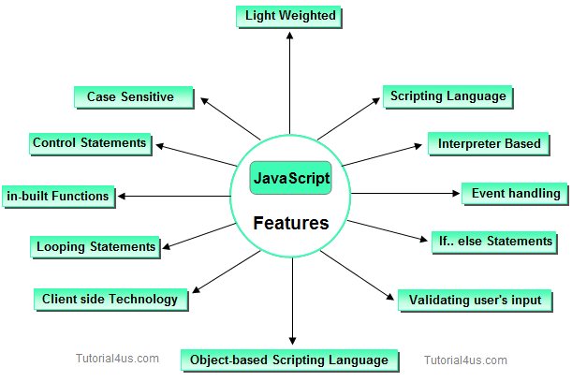
Features of JavaScript JavaScript is a client side technology, it is mainly used for gives client side validation, but it have lot of features which are given below;

Slide 5
Way of Using JavaScript
There are three places to put the JavaScript code.
Between the <body> </body> tag of html (Inline JavaScript)
Between the <head> </head> tag of html (Internal JavaScript)
In .js file (External JavaScript)

Slide 6
How to Put a JavaScript Into an HTML Page?
<html>
<body>
<script type="text/javascript">
document.write("Hello World!")
</script>
</body>
</html>

Slide 7
Inline JavaScript
When java script was written within the html element using attributes related to events of the element then it is called as inline java script.
Example of Inline JavaScript
Example How to use JavaScript
<html> <form> <input type="button" value="Click" onclick="alert('Button Clicked')"/> </form> </html>
Output:
Click

Slide 8
Internal JavaScript
When java script was written within the section using element then it is called as internal java script.
Example of Internal JavaScript
<html>
<head>
<script>
function msg()
{ alert("Welcome in JavaScript"); }
</script>
</head>
<form>
<input type="button" value="Click" onclick="msg()"/>
</form>
</html>
Output:
click

Slide 9
External JavaScript
Writing java script in a separate file with extension .js is called as external java script. For adding the reference of an external java script file to your html page, use tag with src attribute as follows
Example
<script type="text/javascript" src="filename.js"/>
Create a file with name functions.js and write the following java script functions in it.
message.js
Example
function msg() { alert("Welcome in JavaScript"); }

Slide 10
Example
<html>
<head>
<script type="text/javascript" src="message.js">
</script>
</head>
<body>
<form>
<input type="button" value="click" onclick="msg()"/>
</form>
</body>
</html>
output:
click

Slide 11
Hiding JavaScript from Incompatible Browsers
<script type="text/javascript">
<!–
document.writeln("Hello, WWW");
// -->
</script>
<noscript>
Your browser does not support JavaScript.
</noscript>

Slide 12
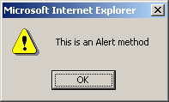
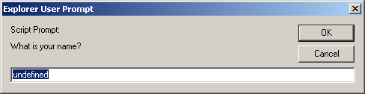
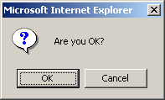
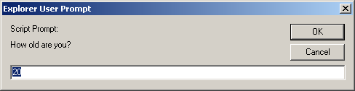
alert(), confirm(), and prompt()
<script type="text/javascript">
alert("This is an Alert method");
confirm("Are you OK?");
prompt("What is your name?");
prompt("How old are you?","20");
</script>

Slide 13
alert() and confirm()
alert("Text to be displayed");
Display a message in a dialog box.
The dialog box will block the browser.
var answer = confirm("Are you sure?");
Display a message in a dialog box with two buttons: "OK" or "Cancel".
confirm() returns true if the user click "OK". Otherwise it returns false.

Slide 14
prompt()
prompt("What is your student id number?");
prompt("What is your name?”, "No name");
Display a message and allow the user to enter a value
The second argument is the "default value" to be displayed in the input textfield.
Without the default value, "undefined" is shown in the input textfield.
If the user click the "OK" button, prompt() returns the value in the input textfield as a string.
If the user click the "Cancel" button, prompt() returns null.

Slide 15
Identifier
Same as Java/C++ except that it allows an additional character – '$'.
Contains only 'A' – 'Z', 'a' – 'z', '0' – '9', '_', '$'
First character cannot be a digit
Case-sensitive
Cannot be reserved words or keywords

Slide 16
Variable and Variable Declaration
<head><script type="text/javascript">
// We are in the default scope – the "window" object.
x = 3; // same as "window.x = 3"
var y = 4; // same as "y = 4" or "window.y = 4"
{ // Introduce a block to creat a local scope
x = 0; // Same as "window.x = 0"
var y = 1; // This is a local variable y
}
alert("x=" + x + ", y=" + y); // Print x=0, y=4
</script></head>
Local variable is declared using the keyword 'var'.
Dynamic binding – a variable can hold any type of value
If a variable is used without being declared, the variable is created automatically.
If you misspell a variable name, program will still run (but works incorrectly)

Slide 17
Data Types
Primitive data types
Number: integer & floating-point numbers
Boolean: true or false
String: a sequence of alphanumeric characters
Composite data types (or Complex data types)
Object: a named collection of data
Array: a sequence of values (an array is actually a predefined object)
Special data types
Null: the only value is "null" – to represent nothing.
Undefined: the only value is "undefined" – to represent the value of an unintialized variable

Slide 18
Strings
A string variable can store a sequence of alphanumeric characters, spaces and special characters.
Each character is represented using 16 bit
You can store Chinese characters in a string.
A string can be enclosed by a pair of single quotes (') or double quote (").
Use escaped character sequence to represent special character (e.g.: \", \n, \t)

Slide 19
typeof operator
var x = "hello", y;
alert("Variable x value is " + typeof x );
alert("Variable y value is " + typeof y );
alert("Variable x value is " + typeof z );
An unary operator that tells the type of its operand.
Returns a string which can be "number", "string", "boolean", "object", "function", "undefined", and "null"
An array is internally represented as an object.

Slide 20
Operators
Arithmetic operators
+, -, *, /, %
Post/pre increment/decrement
++, --
Comparison operators
==, !=, >, >=, <, <=
===, !== (Strictly equals and strictly not equals)
i.e., Type and value of operand must match / must not match

Slide 21
== vs ===
// Type conversion is performed before comparison
var v1 = ("5" == 5); // true
// No implicit type conversion.
// True if only if both types and values are equal
var v2 = ("5" === 5); // false
var v3 = (5 === 5.0); // true
var v4 = (true == 1); // true (true is converted to 1)
var v5 = (true == 2); // false (true is converted to 1)
var v6 = (true == "1") // true

Slide 22
Logical Operators
! – Logical NOT
&& – Logical AND
OP1 && OP2
If OP1 is true, expression evaluates to the value of OP2.
Otherwise the expression evaluates to the value of OP1.
Results may not be a boolean value.
|| – Logical OR
OP1 || OP2
If OP1 is true, expression evaluates to the value of OP1. Otherwise the expression evaluates to the value of OP2.

Slide 23
var tmp1 = null && 1000; // tmp1 is null
var tmp2 = 1000 && 500; // tmp2 is 500
var tmp3 = false || 500; // tmp3 is 500
var tmp4 = "" || null; // tmp4 is null
var tmp5 = 1000 || false; // tmp5 is 1000
// If foo is null, undefined, false, zero, NaN,
// or an empty string, then set foo to 100.
foo = foo || 100;

Slide 24
Operators (continue)
String concatenation operator
+
If one of the operand is a string, the other operand is automatically converted to its equivalent string value.
Assignment operators
=, +=, -=, *=, /=, %=
Bitwise operators
&, |, ^, >>, <<, >>>

Slide 25
Conditional Statements
“if” statement
“if … else” statement
"? :" ternary conditional statement
“switch” statement
The syntax of these statements are similar to those found in C and Java.

Slide 26
Conditional Statements
In JavaScript we have the following conditional statements:
if statement - use this statement if you want to execute some code only if a specified condition is true
if...else statement - use this statement if you want to execute some code if the condition is true and another code if the condition is false
if...else if....else statement - use this statement if you want to select one of many blocks of code to be executed
switch statement - use this statement if you want to select one of many blocks of code to be executed

Slide 27
Conditional Statements - 2
if (condition)
{
code to be executed if condition is true
}
if (condition)
{
code to be executed if condition is true
}
else
{
code to be executed if condition is not true
}

Slide 28
Conditional Statements Examples
<script>
x=3
if(x<0)
{
alert (“negatif”)
}
else
{
alert (“pozitif”)
}
</script>

Slide 29
Conditional Statements Examples - 2
<script>
c=confirm(“Kitap Okuyor musunuz?”)
if(c)
{
alert (“tebrikler walla”)
}
else
{
alert (“ayıp ettiniz ama”)
}
</script>

Slide 30
Conditional Statements Examples - 3
<script>
p=prompt("Ankara'nın plaka numarası nedir?", " ")
if(p=="06")
{
alert("Doğru")
}
else
{
alert("Yanlış")
}
</script>

Slide 31
Built-In Functions
eval(expr)
evaluates an expression or statement
eval("3 + 4"); // Returns 7 (Number)
eval("alert('Hello')"); // Calls the function alert('Hello')
isFinite(x)
Determines if a number is finite
isNaN(x)
Determines whether a value is “Not a Number”

Slide 32
Built-In Functions
parseInt(s)
parseInt(s, radix)
Converts string literals to integers
Parses up to any character that is not part of a valid integer
parseInt("3 chances") // returns 3
parseInt(" 5 alive") // returns 5
parseInt("How are you") // returns NaN
parseInt("17", 8) // returns 15
parseFloat(s)
Finds a floating-point value at the beginning of a string.
parseFloat("3e-1 xyz") // returns 0.3
parseFloat("13.5 abc") // returns 13.5

Slide 33
Events
An event occurs as a result of some activity
e.g.:
A user clicks on a link in a page
Page finished loaded
Mouse cursor enter an area
A preset amount of time elapses
A form is being submitted

Slide 34
Event Handlers
Event Handler – a segment of codes (usually a function) to be executed when an event occurs
We can specify event handlers as attributes in the HTML tags.
The attribute names typically take the form "onXXX" where XXX is the event name.
e.g.:
<a href="…" onClick="alert('Bye')">Other Website</a>

Slide 35
Event Handlers
Event Handlers | Triggered when
onChange | The value of the text field, textarea, or a drop down list is modified
onClick | A link, an image or a form element is clicked once
onDblClick | The element is double-clicked
onMouseDown | The user presses the mouse button
onLoad | A document or an image is loaded
onSubmit | A user submits a form
onReset | The form is reset
onUnLoad | The user closes a document or a frame
onResize | A form is resized by the user
For a complete list, see http://www.w3schools.com/htmldom/dom_obj_event.asp

Slide 36
onClick Event Handler Example
<html>
<head>
<title>onClick Event Handler Example</title>
<script type="text/javascript">
function warnUser() {
return confirm("Are you a student?”);
}
</script>
</head>
<body>
<a href="ref.html" onClick="return warnUser()">
<!--
If onClick event handler returns false, the link
is not followed.
-->
Students access only</a>
</body>
</html>

Slide 37
onLoad Event Handler Example
<html><head>
<title>onLoad and onUnload Event Handler Example</title>
</head>
<body
onLoad="alert('Welcome to this page')"
onUnload="alert('Thanks for visiting this page')"
>
Load and UnLoad event test.
</body>
</html>

Slide 38
onMouseOver & onMouseOut Event Handler
<html>
<head>
<title>onMouseOver / onMouseOut Event Handler Demo</title>
</head>
<body>
<a href="http://www.cuhk.edu.hk"
onMouseOver="window.status='CUHK Home'; return true;"
onMouseOut="status=''"
>CUHK</a>
</body>
</html>
When the mouse cursor is over the link, the browser displays the text "CUHK Home" instead of the URL.
The "return true;" of onMouseOver forces browser not to display the URL.
window.status and window.defaultStatus are disabled in Firefox.

Slide 39
onSubmit Event Handler Example
<html><head>
<title>onSubmit Event Handler Example</title>
<script type="text/javascript">
function validate() {
// If everything is ok, return true
// Otherwise return false
}
</script>
</head>
<body>
<form action="MessageBoard" method="POST"
onSubmit="return validate();"
>
…
</form></body></html>
If onSubmit event handler returns false, data is not submitted.
If onReset event handler returns false, form is not reset

Slide 40
Build-In JavaScript Objects
Object | Description
Array | Creates new array objects
Boolean | Creates new Boolean objects
Date | Retrieves and manipulates dates and times
Error | Returns run-time error information
Function | Creates new function objects
Math | Contains methods and properties for performing mathematical calculations
Number | Contains methods and properties for manipulating numbers.
String | Contains methods and properties for manipulating text strings
See online references for complete list of available methods in these objects: http://javascript-reference.info/

Slide 41
String Object (Some useful methods)
length
A string property that tells the number of character in the string
charAt(idx)
Returns the character at location "idx"
toUpperCase(), toLowerCase()
Returns the same string with all uppercase/lowercase letters
substring(beginIdx)
Returns a substring started at location "beginIdx"
substring(beginIdx, endIdx)
Returns a substring started at "beginIdx" until "endIdx" (but not including "endIdx"
indexOf(str)
Returns the position where "str" first occurs in the string

Slide 42
Error and Exception Handling in JavaScript
Javascript makes no distinction between Error and Exception (Unlike Java)
Handling Exceptions
The onError event handler
A method associated with the window object.
It is called whenever an exception occurs
The try … catch … finally block
Similar to Java try … catch … finally block
For handling exceptions in a code segment
Use throw statement to throw an exception
You can throw value of any type
The Error object
Default object for representing an exception
Each Error object has a name and message properties

Slide 43
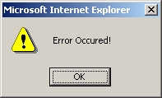
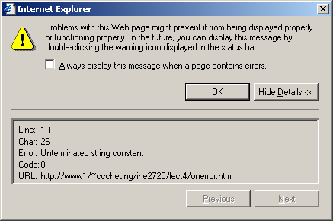
How to use “onError” event handler?
<html>
<head>
<title>onerror event handler example</title>
<script type="text/javascript">
function errorHandler(){
alert("Error Ourred!");
}
// JavaScript is casesensitive
// Don't write onerror!
window.onError = errorHandler;
</script>
</head>
<body>
<script type="text/javascript">
document.write("Hello there;
</script>
</body>
</html>

Slide 44
try … catch … finally
try {
// Contains normal codes that might throw an exception.
// If an exception is thrown, immediately go to
// catch block.
} catch ( errorVariable ) {
// Codes here get executed if an exception is thrown
// in the try block.
// The errorVariable is an Error object.
} finally {
// Executed after the catch or try block finish
// Codes in finally block are always executed
}
// One or both of catch and finally blocks must accompany the try block.

Slide 45
try … catch … finally example
<script type="text/javascript">
try{
document.write("Try block begins<br>");
// create a syntax error
eval ("10 + * 5");
} catch( errVar ) {
document.write("Exception caught<br>");
// errVar is an Error object
// All Error objects have a name and message properties
document.write("Error name: " + errVar.name + "<br>");
document.write("Error message: " + errVar.message +
"<br>");
} finally {
document.write("Finally block reached!");
}
</script>

Slide 46
Throwing Exception
<script type="text/javascript">
try{
var num = prompt("Enter a number (1-2):", "1");
// You can throw exception of any type
if (num == "1")
throw "Some Error Message";
else
if (num == "2")
throw 123;
else
throw new Error ("Invalid input");
} catch( err ) {
alert(typeof(errMsg) + "\n" + err);
// instanceof operator checks if err is an Error object
if (err instanceof Error)
alert("Error Message: " + err.message);
}
</script>

Slide 47
Document Object Model (DOM)
When a web page is loaded, the browser creates a Document Object Model of the page.
Representation of the current web page as a tree of Javascript objects
allows you to view/modify page elements in script code after page has loaded
client side = highly responsive interactions
browser-independent
allows progressive enhancement.

Slide 48


Slide 49
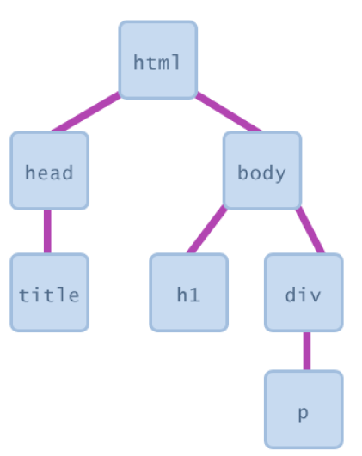

Slide 50
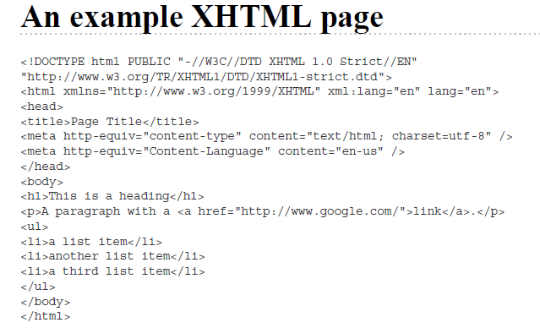

Slide 51
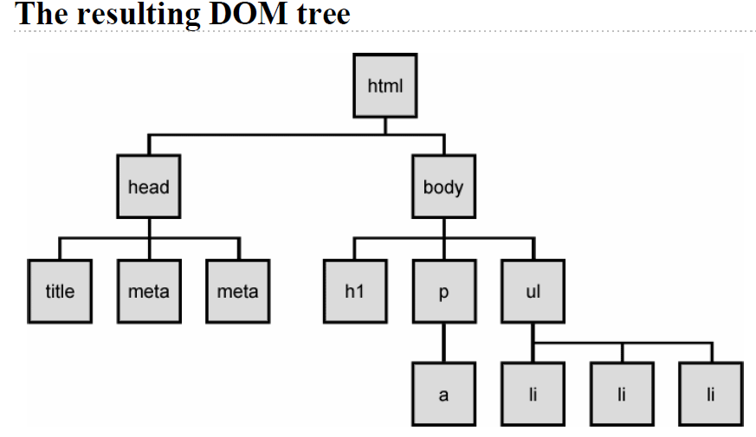

Slide 52
With the object model, JavaScript gets all the power it needs to create dynamic HTML:
JavaScript can change all the HTML elements in the page
JavaScript can change all the HTML attributes in the page
JavaScript can change all the CSS styles in the page
JavaScript can remove existing HTML elements and attributes
JavaScript can add new HTML elements and attributes
JavaScript can react to all existing HTML events in the page
JavaScript can create new HTML events in the page

Slide 53
What is the DOM?
The DOM is a W3C (World Wide Web Consortium) standard.
The DOM defines a standard for accessing documents:
"The W3C Document Object Model (DOM) is a platform and language-neutral interface that allows programs and scripts to dynamically access and update the content, structure, and style of a document."
The W3C DOM standard is separated into 3 different parts:
Core DOM - standard model for all document types
XML DOM - standard model for XML documents
HTML DOM - standard model for HTML documents

Slide 54
What is the HTML DOM?
The HTML DOM is a standard object model and programming interface for HTML. It defines:
The HTML elements as objects
The properties of all HTML elements
The methods to access all HTML elements
The events for all HTML elements

Slide 55
JavaScript - HTML DOM Methods
HTML DOM methods are actions you can perform (on HTML Elements).
HTML DOM properties are values (of HTML Elements) that you can set or change.

Slide 56
The DOM Programming Interface
The HTML DOM can be accessed with JavaScript (and with other programming languages).
In the DOM, all HTML elements are defined as objects.
The programming interface is the properties and methods of each object.
A property is a value that you can get or set (like changing the content of an HTML element).
A method is an action you can do (like add or deleting an HTML element).

Slide 57
Example
The following example changes the content (the innerHTML) of the <p> element with id="demo":
<html> <body> <p id="demo"></p> <script> document.getElementById("demo").innerHTML = "Hello World!"; </script> </body> </html>

Slide 58
The getElementById Method
The most common way to access an HTML element is to use the id of the element.
In the example above the getElementById method used id="demo" to find the element.
The innerHTML Property
The easiest way to get the content of an element is by using the innerHTML property.
The innerHTML property is useful for getting or replacing the content of HTML elements.
The innerHTML property can be used to get or change any HTML element, including <html> and <body>.

Slide 59
The HTML DOM Document Object
The document object represents your web page.
If you want to access any element in an HTML page, you always start with accessing the document object.
Below are some examples of how you can use the document object to access and manipulate HTML.

Slide 60
JavaScript Objects
Real Life Objects, Properties, and Methods
In real life, a car is an object.
A car has properties like weight and color, and methods like start and stop:
ObjectProperties 1.car.name = Fiat 2.car.model = 500 3.car.weight = 850kg 4.car.color = white
Methods
1.car.start() 2.car.drive() 3.car.brake() 4.car.stop()

Slide 61
All cars have the same properties, but the property values differ from car to car.
All cars have the same methods, but the methods are performed at different times.
JavaScript Objects
You have already learned that JavaScript variables are containers for data values.
This code assigns a simple value (Fiat) to a variable named car:

Slide 62
<!DOCTYPE html>
<html>
<body>
<p>Creating a JavaScript Variable.</p>
<p id="demo"></p>
<script>
var car = "Fiat";
document.getElementById("demo").innerHTML = car;
</script>
</body>
</html>

Slide 63
Objects are variables too. But objects can contain many values.
This code assigns many values (Fiat, 500, white) to a variable named car:
<!DOCTYPE html>
<html>
<body>
<p>Creating a JavaScript Object.</p>
<p id="demo"></p>
<script>
var car = {type:"Fiat", model:"500", color:"white"};
document.getElementById("demo").innerHTML = car.type;
</script>
</body>
</html>
The values are written as name:value pairs (name and value separated by a colon).

Slide 64
Object Properties
The name:values pairs (in JavaScript objects) are called properties.
var person = {firstName:"John", lastName:"Doe", age:50, eyeColor:"blue"};
Object Methods:
Methods are actions that can be performed on objects.
Methods are stored in properties as function definitions.

Slide 65
Object Definition
You define (and create) a JavaScript object with an object literal:
Example
var person = {firstName:"John", lastName:"Doe", age:50, eyeColor:"blue"};
var person = { firstName:"John", lastName:"Doe", age:50, eyeColor:"blue" };

Slide 66
Accessing Object Properties
You can access object properties in two ways:
objectName.propertyName
Or
objectName["propertyName"]
Example1
person.lastName;
Example2
person["lastName"];

Slide 67
<!DOCTYPE html>
<html>
<body>
<p>
There are two different ways to access an object property:
</p>
<p>You can use person.property or person["property"].</p>
<p id="demo"></p>
<script>
var person = {
firstName: "John",
lastName : "Doe",
id : 5566
};
document.getElementById("demo").innerHTML =
person.firstName + " " + person.lastName;
</script>
</body>
</html>

Slide 68
<!DOCTYPE html>
<html>
<body>
<p>
There are two different ways to access an object property:
</p>
<p>You can use person.property or person["property"].</p>
<p id="demo"></p>
<script>
var person = {
firstName: "John",
lastName : "Doe",
id : 5566
};
document.getElementById("demo").innerHTML =
person["firstName"] + " " + person["lastName"];
</script>
</body>
</html>

Slide 69
Accessing Object Methods
You access an object method with the following syntax:
objectName.methodName()
Example
name = person.fullName();

Slide 70
<!DOCTYPE html>
<html>
<body>
<p>Creating and using an object method.</p>
<p>An object method is a function definition, stored as a property value.</p>
<p id="demo"></p>
<script>
var person = {
firstName: "John",
lastName : "Doe",
id : 5566,
fullName : function() {
return this.firstName + " " + this.lastName;
}
};
document.getElementById("demo").innerHTML = person.fullName();
</script>
</body>
</html>

Slide 71
The Document Object
A document is a web page that is being either displayed or created. The document has a number of properties that can be accessed by JavaScript programs and used to manipulate
the content of the page.
write or writeln
Html pages can be created on the fly using JavaScript. This is done by using the write or writeln methods of the document object.
Syntax:document.write (“String”); document.writeln (“String”);
In this document is object name and write () or writeln () are methods. Symbol period is used as connector between object name and method name. The difference between these two methods is carriage form feed character that is new line character automatically added into the document.
Exmaple: document.write(“<body>”); document.write(“<h1> Hello </h1>”);

Slide 72
bgcolor and fgcolor
These are used to set background and foreground(text) color to webpage. The methods accept either hexadecimal values or common names for colors.
Syntax: document.bgcolor=”#1f9de1”; document.fgcolor=“silver”;
anchors
The anchors property is an array of anchor names in the order in which they appear in the HTML Document. Anchors can be accessed like this:
Syntax:
document.anchors[0];
document.anchors[n-1];
Links
Another array holding all links in the order in which they were appeared on the Webpage
Forms
Another array, this one contains all of the HTML forms. By combining this array with the individual form objects each form item can be accessed.

Slide 73
The Window Object
The window object is used to create a new window and to control the properties of window.
Methods:
open(“URL”,”name”) : This method opens a new window which contains the document specified by URL and the new window is identified by its name.
close(): this shutdowns the current window.
Properties:
toolbar = [1|0] location= [1|0] menubar = [1|0] scrollbars = [1|0] status = [1|0] resizable = [1|0]
where as 1 means on and 0 means off
height=pixels, width=pixels : These properties can be used to set the window size.
The following code shows how to open a new window
newWin = open(“first.html”,”newWin”,”status=0,toolbar=0,width=100,height=100”);

Slide 74
Window object supports three types of message boxes.
Alert box Confirm box Prompt box
Alert box is used to display warning/error messages to user. It displays a text string with OK button.
Syntax: window. Alert (“Message”);

Slide 75
Confirm Box is useful when submitting form data. This displays a window containing message with two buttons: OK and Cancel. Selecting Cancel will abort the any pending action, while OK will let the action proceed.
Syntax
window.confirm(“String”);

Slide 76
Prompt box used for accepting data from user through keyboard. This displays simple window that contains a prompt and a text field in which user can enter data. This method has two parameters: a text string to be used as a prompt and a string to use as the default value. If you don‟t want to display a default then simply use an empty string. Syntax
Variable=window.prompt(“string”,”default value”);

Slide 77
The Form Object
Two aspects of the form can be manipulated through JavaScript. First, most commonly and probably most usefully, the data that is entered onto your form can be checked at submission. Second you can actually build forms through JavaScript.
Form object supports three events to validate the form
onClick = “method()”
This can be applied to all form elements. This event is triggered when the user clicks on the element.
onSubmit = “method()”
This event can only be triggered by form itself and occurs when a form is submitted.
onReset = “method()”
This event can only be triggered by form itself and occurs when a form is reset.

Slide 78
The browser Object
The browser is JavaScript object that can be used to know the details of browser. Some of the properties of the browser object is as follows:
Property | Description
navigator.appCodeName | It returns the internal name for the browser. For major browsers it is Mozilla
navigator.appName | It returns the public name of the browser – navigator or Internet Explorer
navigator.appVersion | It returns the version number, platform on which the browser is running.
navigator.userAgent | The strings appCodeName and appVersion concatenated together
navigator.plugins | An array containing details of all installed plug-ins
Navigator.mimeTypes | An array of all supported MIME Types

Slide 79
The Math Object
The Math object holds all mathematical functions and values. All the functions and attributes used in complex mathematics must be accessed via this object.
Syntax:
Math.methodname();
Math.value;

Slide 80
Method | Description | Example
Math.abs(x) | Returns the absolute value | Math.abs(-20) is 20
Math.ceil(x) | Returns the ceil value | Math.ceil(5.8) is 6 Math.ceil(2.2) is 3
Math.floor(x) | Returns the floor value | Math.floor(5.8) is 5 Math.floor(2.2) is 2
Math.round(x) | Returns the round value, nearest integer value | Math.round(5.8) is 6 Math.round(2.2) is 2
Math.trunc(x) | Removes the decimal places it returns only integer value | Math.trunc(5.8) is 5 Math.trunc(2.2) is 2
Math.max(x,y) | Returns the maximum value | Math.max(2,3) is 3 Math.max(5,2) is 5
Math.min(x,y) | Returns the minimum value | Math.min(2,3) is 2 Math.min(5,2) is 2
Math.sqrt(x) | Returns the square root of x | Math.sqrt(4) is 2

Slide 81
Math.pow(a,b) | This method will compute the a^{b} | Math.pow(2,4) is 16
Math.sin(x) | Returns the sine value of x | Math.sin(0.0) is 0.0
Math.cos(x) | Returns cosine value of x | Math.cos(0.0) is 1.0
Math.tan(x) | Returns tangent value of x | Math.tan(0.0) is 0
Math.exp(x) | Returns exponential value i.e e^{x} | Math.exp(0) is 1
Math.random(x) | Generates a random number in between 0 and 1 | Math.random()
Math.log(x) | Display logarithmic value | Math.log(2.7) is 1
Math.PI | Returns a ∏ value | a = Math.PI; a = 3.141592653589793

Slide 82
The Date Object
This object is used for obtaining the date and time. In JavaScript, dates and times represent in milliseconds since 1st January 1970 UTC. JavaScript supports two time zones: UTC and local. UTC is Universal Time, also known as Greenwich Mean Time(GMT), which is standard time throughout the world. Local time is the time on your System. A JavaScript Date represents date from -1,000,000,000 to -1,000,000,000 days relative to 01/01/1970.
Date Object Constructors:
new Date(); Constructs an empty date object.
new Date(“String”); Creates a Date object based upon the contents of a text string.
new Date(year, month, day[,hour, minute, second] ); Creates a Date object based upon the numerical values for the year, month and day.
var dt=new Date();
document.write(dt); // Tue Dec 23 11:23:45 UTC+0530 2015

Slide 83
<!DOCTYPE html>
<html>
<body>
<p id="demo"></p>
<script>
document.getElementById("demo").innerHTML = Date();
</script>
</body>
</html>
output:
Mon Jan 29 2018 09:20:16 GMT+0530 (India Standard Time)

Slide 84
JavaScript Date Methods
Date methods let you get and set date values (years, months, days, hours, minutes, seconds, milliseconds)
Method | Description
getDate() | Get the day as a number (1-31)
getDay() | Get the weekday as a number (0-6)
getFullYear() | Get the four digit year (yyyy)
getHours() | Get the hour (0-23)
getMilliseconds() | Get the milliseconds (0-999)
getMinutes() | Get the minutes (0-59)
getMonth() | Get the month (0-11)

Slide 85
JavaScript Arrays
JavaScript arrays are used to store multiple values in a single variable.
Displaying Arrays
<!DOCTYPE html>
<html>
<body>
<p id="demo"></p>
<script>
var cars = ["Saab", "Volvo", "BMW"];
document.getElementById("demo").innerHTML = cars[0];
</script>
</body>
</html>

Slide 86
Creating an Array
Using an array literal is the easiest way to create a JavaScript Array.
Syntax:
var array-name = [item1, item2, ...];
Using the JavaScript Keyword new
The following example also creates an Array, and assigns values to it:
var cars = new Array("Saab", "Volvo", "BMW");
Access the Elements of an Array
You refer to an array element by referring to the index number.
var name = cars[0];
This statement modifies the first element in cars:
cars[0] = "Opel";
Can Have Different Objects in One Array
JavaScript variables can be objects. Arrays are special kinds of objects.
Because of this, you can have variables of different types in the same Array.
Example:
myArray[0] = Date.now; myArray[1] = myFunction; myArray[2] = myCars;
Cont..

Slide 87
Cont..
Arrays are Objects
Arrays are a special type of objects. The typeof operator in JavaScript returns "object" for arrays.
But, JavaScript arrays are best described as arrays.
Arrays use numbers to access its "elements". In this example, person[0] returns John:
Array: var person = ["John", "Doe", 46];
Objects use names to access its "members". In this example, person.firstName returns John:
Object: var person = {firstName:"John", lastName:"Doe“, age:46};
Array Properties and Methods
The real strength of JavaScript arrays are the built-in array properties and methods:
Examples
var x = cars.length; // The length property returns the number of elements in cars var y = cars.sort(); // The sort() method sort cars in alphabetical order

Slide 88
Cont..
Note:
var points = new Array(); // Bad
var points = []; // Good
When to Use Arrays? When to use Objects?
JavaScript does not support associative arrays.
You should use objects when you want the element names to be strings.
You should use arrays when you want the element names to be sequential numbers.

Slide 89
Array Object Methods
Cont..
Method | Description
concat() | Joins two or more arrays, and returns a copy of the joined arrays
indexOf() | Search the array for an element and returns its position
join() | Joins all elements of an array into a string
lastIndexOf() | Search the array for an element, starting at the end, and returns its position
pop() | Removes the last element of an array, and returns that element
push() | Adds new elements to the end of an array, and returns the new length
reverse() | Reverses the order of the elements in an array
shift() | Removes the first element of an array, and returns that element
slice() | Selects a part of an array, and returns the new array
sort() | Sorts the elements of an array
splice() | Adds/Removes elements from an array
toString() | Converts an array to a string, and returns the result
unshift() | Adds new elements to the beginning of an array, and returns the new length
valueOf() | Returns the primitive value of an array

Slide 90
Cont..
Concat():Joins two or more arrays, and returns a copy of the joined arrays.
Syntax: array.concat(array1,array2…..);
Ex:
var hege = ["Cecilie", "Lone"]; var stale = ["Emil", "Tobias", "Linus"]; var kai = ["Robin"]; var children = hege.concat(stale,kai);
indexOf():this method searches the array for the specified item, and returns its position.
The search will start at the specified position, or at the beginning if no start position is specified, and end the search at the end of the array.
Returns -1 if the item is not found.
If the item is present more than once, the indexOf method returns the position of the first occurrence.
Syntax: array.indexOf(item);
Ex: var fruits=[“Banana”,Orange”,”Apple”,”Mango”];
var x=fruits.indexOf(“Apple”);
Here the value of x is:2 i.e. Apple is at position 2.

Slide 91
Cont..
Join():The join() method joins the elements of an array into a string, and returns the string.
The elements will be separated by a specified separator. The default separator is comma (,).
Syntax: array.join();
Ex: var fruits=[“Banana” Orange”,”Apple”,”Mango”];
var x=fruits.join();
the result of x will be Banana,Orange,Apple,Mango.
Slice(): The slice() method returns the selected elements in an array, as a new array object.
The slice() method selects the elements starting at the given start argument, and ends at, but does not include, the given end argument.
Syntax: array.slice (start, end);
Ex: var fruits=[“Banana”,Orange”,”Apple”,”Mango”];
var x=fruits.slice(1,3);
the result of x will be [Orange,Apple];
Splice(): The splice() method adds/removes items to/from an array, and returns the removed item(s).
Syntax: array.splice(index,howmany,item1,item2….);
Ex: var fruits=[“Banana”,Orange”,”Apple”,”Mango”];
fruits.splice(2,1,”Lemon”,”Kiwi”);
the result of fruits will be [Banana,Orange,Lemon,Kiwi,Mango]

Slide 92
Arrays Operations and Properties
Cont..
Declaring new empty array:
Declaring an array holding few elements:
Appending an element / getting the last element:
Reading the number of elements (array length):
Finding element's index in the array:
var arr = new Array();
var arr = [1, 2, 3, 4, 5];
arr.push(3);
var element = arr.pop();
arr.length;
arr.indexOf(1);

Slide 93
JavaScript Regular Expressions
A regular expression is a sequence of characters that forms a search pattern.
The search pattern can be used for text search and text replace operations.
Syntax
/pattern/modifiers;
Example:
var patt = /w3schools/I
/w3schools/i is a regular expression.
w3schools is a pattern (to be used in a search).
i is a modifier (modifies the search to be case-insensitive)

Slide 94
Cont..
Using String Methods
In JavaScript, regular expressions are often used with the two string methods: search() and replace().
The search(pattern) method uses an expression to search for a match, and returns the position of the match.
The replace(pattern1, pattern2) method returns a modified string where the pattern is replaced.
The split(pattern) method
The match(pattern) method searches for a matching pattern. Returns an array holding the results, or null if no match is found.
Example
var str = "Visit W3Schools"; var n = str.search(/w3schools/i);
The result in n will be: 6
Example
var str = "Visit Microsoft!"; var res = str.replace(/microsoft/i, "W3Schools");
The result in res will be: Visit W3Schools!

Slide 95
Cont..
Regular Expression Modifiers
Modifiers can be used to perform case-insensitive more global searches: Modifier Description
i Perform case-insensitive matching
g Perform a global match (find all matches rather than stopping after the first match)
m Perform multiline matching
Regular Expression Patterns
Brackets are used to find a range of characters:
Expression Description
[abc] Find any of the characters between the brackets
[0-9] Find any of the digits between the brackets
(x|y) Find any of the alternatives separated with |

Slide 96
Metacharacters are characters with a special meaning:
Cont..
Metacharacter / Token | Description
\d | Find a digit
\s | Find a whitespace character
\b | Find a match at the beginning or at the end of a word
\uxxxx | Find the Unicode character specified by the hexadecimal number xxxx
^ | Match at the start of the input string
$ | Match at the end of the input string
* | Match 0 or more times
+ | Match 0 or more times
? | Match 0 or 1 times
{n} | Match the string n times
\D | Match anything except for digits

Slide 97
Metacharacter / Token | Description
\w | Match any alphanumeric character or the underscore
\W | Match anything except alphanumeric characters or underscore
\S | Match anything except for whitespace characters
[…] | Creates a set of characters, one of which must match if the operation is to be successful. If you need a range of characters then separate the first and last with a hypen: [0-9] or [D-G]
[^…] | Creates a set of characters which doesnot match. If any character in the set matches then the operation has failed. This fails if any lowercase letter from d to q is matched: [^d-q].
Quantifiers define quantities:
Quantifier | Description
n+ | Matches any string that contains at least one n
n* | Matches any string that contains zero or more occurrences of n
n? | Matches any string that contains zero or one occurrences of n
Cont..

Slide 98
Cont..
Using the RegExp Object
In JavaScript, the RegExp object is a regular expression object with predefined properties and methods.
Using test() / using exec()
The test() method is a RegExp expression method.
It searches a string for a pattern, and returns true or false, depending on the result.
The following example searches a string for the character "e":
Example
var patt = /e/; patt.test("The best things in life are free!");
(or)
/e/.test("The best things in life are free!")
Since there is an "e" in the string, the output of the code above will be: true

Slide 99
constructor
It returns a reference to the array function that created the instance's prototype.
Syntax
Its syntax is as follows:
RegExp.constructor
Return Value
Returns the function that created this object's instance.

Slide 100
Example
Try the following example program.
<html>
<head>
<title>JavaScript RegExp constructor Property</title>
</head>
<body>
<script type="text/javascript">
var re = new RegExp( "string" );
document.write("re.constructor is:" + re.constructor);
</script>
</body>
</html>
Output
re.constructor is:function RegExp() { [native code]

Slide 101
global
global is a read-only boolean property of RegExp objects. It specifies whether a particular regular expression performs global matching, i.e., whether it was created with the "g" attribute.
Syntax
Its syntax is as follows:
RegExpObject.global
Return Value
Returns "TRUE" if the "g" modifier is set, "FALSE" otherwise.

Slide 102
<html>
<head>
<title>JavaScript RegExp global Property</title>
</head>
<body>
<script type="text/javascript">
var re = new RegExp( "string" );
if ( re.global ){
document.write("Test1 - Global property is set");
}else{
document.write("Test1 - Global property is not set");
}
re = new RegExp( "string", "g" );
if ( re.global ){
document.write("<br />Test2 - Global property is set");
}else{
document.write("<br />Test2 - Global property is not set");
}
</script>
</body>
</html>
Output
Test1 - Global property is not set
Test2 - Global property is set

Slide 103
ignoreCase
ignoreCase is a read-only boolean property of RegExp objects. It specifies whether a particular regular expression performs case-insensitive matching, i.e., whether it was created with the "i" attribute.
Syntax
Its syntax is as follows:
RegExpObject.ignoreCase
Return Value
Returns "TRUE" if the "i" modifier is set, "FALSE" otherwise.

Slide 104
<html>
<head>
<title>JavaScript RegExp ignoreCase Property</title>
</head>
<body>
<script type="text/javascript">
var re = new RegExp( "string" );
if ( re.ignoreCase ){
document.write("Test1 - ignoreCase property is set");
}else{
document.write("Test1 - ignoreCase property is not set");
}
re = new RegExp( "string", "i" );
if ( re.ignoreCase ){
document.write("<br />Test2 - ignoreCase property is set");
}else{
document.write("<br />Test2 - ignoreCase property is not set");
}
</script>
</body>
</html>

Slide 105
Output
Test1 - ignoreCase property is not set
Test2 - ignoreCase property is set

Slide 106
lastIndex
lastIndex is a read/write property of RegExp objects. For regular expressions with the "g" attribute set, it contains an integer that specifies the character position immediately following the last match found by the RegExp.exec() and RegExp.test() methods. These methods use this
property as the starting point for the next search they conduct.

Slide 107
This property is read/write, so you can set it at any time to specify where in the target string, the next search should begin. exec() and test() automatically reset the lastIndex to 0 when they fail to find a match (or another match).
Syntax
Its syntax is as follows:
RegExpObject.lastIndex
Return Value
Returns an integer that specifies the character position immediately following the last match.

Slide 108
<html>
<head>
<title>JavaScript RegExp lastIndex Property</title>
</head>
<body>
<script type="text/javascript">
var str = "Javascript is an interesting scripting language";
var re = new RegExp( "script", "g" );
re.test(str);
document.write("Test 1 - Current Index: " + re.lastIndex);
re.test(str);
document.write("<br />Test 2 - Current Index: " + re.lastIndex);
</script>
</body>
</html>
Output
Test 1 - Current Index: 10
Test 2 - Current Index: 35

Slide 109
multiline
multiline is a read-only boolean property of RegExp objects. It specifies whether a particular regular expression performs multiline matching, i.e., whether it was created with the "m" attribute.
Syntax
Its syntax is as follows:
RegExpObject.multiline
Return Value
Returns "TRUE" if the "m" modifier is set, "FALSE" otherwise.

Slide 110
<html>
<head>
<title>JavaScript RegExp multiline Property</title>
</head>
<body>
<script type="text/javascript">
var re = new RegExp( "string" );
if ( re.multiline ){
document.write("Test1-multiline property is set");
}else{
document.write("Test1-multiline property is not set");
}
re = new RegExp( "string", "m" );
if ( re.multiline ){

Slide 111
document.write("<br/>Test2-multiline property is set");
}else{
document.write("<br/>Test2-multiline property is not set");
}
</script>
</body>
</html>
Output
Test1-multiline property is not set
Test2-multiline property is set

Slide 112
source
source is a read-only string property of RegExp objects. It contains the text of the RegExp pattern. This text does not include the delimiting slashes used in regular-expression literals, and it does not include the "g", "i", and "m“ attributes.
Syntax
Its syntax is as follows:
RegExpObject.source
Return Value
Returns the text used for pattern matching.

Slide 113
<html>
<head>
<title>JavaScript RegExp source Property</title>
</head>
<body>
<script type="text/javascript">
var str = "Javascript is an interesting scripting language";
var re = new RegExp( "script", "g" );
re.test(str);
document.write("The regular expression is : " + re.source);
</script>
</body>
</html>
Output
The regular expression is : script

Slide 114
Exception Handling Try… Catch and Throw statements
Catching errors in JavaScript:
It is very important that the errors thrown must be catched or trapped so that they can be handled more efficiently and conveniently and the users can move better through the web page.
Using try…catch statement:
The try..catch statement has two blocks in it:
· try block
· catch block
In the try block, the code contains a block of code that is to be tested for errors.
The catch block contains the code that is to be executed if an error occurs. The general syntax of try..catch statement is as follows:

Slide 115
Exception Handling
throw
Example:
do something
if an error happens
{
create a new exception object
throw the exception
}
try……..
Example: try
{
statement one
statement two
statement three
}
catch
Example:
catch exception
{
handle the exception }

Slide 116
The concept of try…catch statement
<html>
<head>
<script type="text/javascript">
try
{
document.write(junkVariable)
}
catch(err)
{
document.write(err.message + "<br/>")
}
</script>
</head>
<body>
</body>
</html>

Slide 117
The output of the above program is ‘junkVariable’ is undefined
In the above program, the variable junkVariableis undefined and the usage of this in try block gives an error. The control is transferred to the catch block with this error and this error message is printed in the catch block.

Slide 118
throw in JavaScript:
There is another statement called throw available in JavaScript that can be used along
with try…catch statements to throw exceptions and thereby helps in generating. General
syntax of this throw statement is as follows:
throw(exception)
exception can be any variable of type integer or boolean or string.

Slide 119
<html>
<head>
<script type="text/javascript">
try
{
varexfor=10
if(exfor!=20)
{
throw "PlaceError"
}
}
catch(err)
{
if(err == "PlaceError")
document.write ("Example to illustrate Throw
Statement: Variable exfor not equal to 20.
<br/>")
}
</script>
</head>
<body>
</body>
</html>
The output of the above program is:
Example to illustrate Throw Statement: Variable exfor not equal to 20.

Slide 120
In the above example program, the try block has the variable exfor initialized to 10. Using the if statement, the variable value is checked to see whether it is equal to 20. Since exfor is not equal to 20, the exception is thrown using the throw statement. This is named Place Error and the control transfers to the catch block. The error catched is checked and since this is equal to the PlaceError, the statement placed inside the error message is displayed and the output is displayed as above.

Slide 121
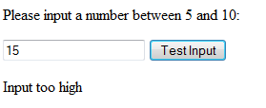
Example: <!DOCTYPE html>
<html>
<body>
<p>Please input a number between 5 and 10:</p>
<input id="demo" type="text">
<button type="button" onclick="myFunction()">Test Input</button>
<p id="message"></p>
<script>
function myFunction() {
var message, x;
message = document.getElementById("message");
message.innerHTML = "";
x = document.getElementById("demo").value;
try {
if(x == "") throw "is Empty";
if(isNaN(x)) throw "not a number";
if(x > 10) throw "too high";
if(x < 5) throw "too low";
}
catch(err) {
message.innerHTML = "Input " + err;
}
}
</script></body></html>
Cont..

Slide 122
Form validation program example
<html>
<head>
<script language="javascript">
function validate()
{
var x=f1.t1.value;
var y=f1.t2.value;
var re=/\d|\W|_/g;
if(x==''||y=='')
window.alert("Enter both user id and password");
else if(x.length<6||y.length<6)
window.alert("both user id and password should greater than or equal to 6");
else if((re.test(x)))
window.alert("user name show3uld be alphabets");
else
window.alert("welcome"+" Mr."+x);
}

Slide 123
</script>
</head>
<body bgcolor="green">
<form name="f1">
<center>
User Name<input type="text" name="t1"><br><br>
Password <input type="password" name="t2"><br><br>
<input type="submit" value="submit" onClick=validate()>
<input type="reset" value="reset">
</center>
</form>
</body>
</html>

Slide 124
DYNAMIC HTML
DHTML is combination of HTML, CSS and JavaScript. It gives pleasant appearance to web page.
Difference between HTML and DHTML
HTML | DHTML
HTML is used to create static web pages. | DHTML is used to create dynamic web pages.
HTML is consists of simple html tags. | DHTML is made up of HTML tags+cascading style sheets+javascript.
Creation of html web pages is simplest but less interactive. | Creation of DHTML is complex but more interactive.

Slide 125
Dynamic HTML, or DHTML, is for a collection of technologies used together to create
interactive and animated by using a combination of a static markup language (such as HTML), a client-side scripting language (such as JavaScript), a presentation definition language (such as CSS), and the Document Object Model.

Slide 126
Uses
DHTML allows authors to add effects to their pages that are otherwise difficult to achieve.
For example, DHTML allows the page author to:
Animate text and images in their document, independently moving each element from any starting point to any ending point, following a predetermined path or one chosen by the user.
· Embed a ticker that automatically refreshes its content with the latest news, stock quotes, or other data.
· Use a form to capture user input, and then process and respond to that data without having to send data back to the server.
· Include rollover buttons or drop-down menus.

Slide 127
DHTML FORMS
Forms are key components of all Web-based applications. But important as they are, Web developers often present users with forms that are difficult to use.
There are three common problems:
Forms can be too long. A seemingly endless list of questions is to make sure the user click the back button or jump to another site.
In many situations a specific user will need to fill out only some of the form elements. If you present needless questions to a user, you’ll add clutter to your page and encourage the user to go elsewhere.
Form entries often need to conform to certain formats and instructions. Adding this information to a Web page can make for a cluttered and unappealing screen.

Slide 128
Summary of the unit:
1.DOM
2.Ojects in java script
3.Arrays concept
4.RegEx
5.Exception Handling-try,catch and throw
6.DHTML-HTML+CSS+JAVASCRIPT

Slide 129
Servlet
Servlet technology is used to create web application (resides at server side and generates dynamic web page).

Slide 130
Servlet is a java based server side web technology allows us to develop dynamic web component having ability to develop dynamic web pages.
Servlet is a JEE module based technology executes at server side having capabilty to extend functionality to web server,application server.
Servlet is a JEE module web technology(server side) that allows to develop single instance multiple thread based server based technology web component.
Servlet is JEE module web technology given set of rules and guidelines for vendor companies to develop servlet container & given application for programmers to develop server side web components.

Slide 131
Servlet technology is robust and scalable because of java language. Before Servlet, CGI (Common Gateway Interface) scripting language was popular as a server-side programming language. But there was many disadvantages of this technology. We have discussed these disadvantages below.
There are many interfaces and classes in the servlet API such as Servlet, GenericServlet, HttpServlet, ServletRequest, ServletResponse etc.

Slide 132
What is a Servlet?
Servlet can be described in many ways, depending on the context.
Servlet is a technology i.e. used to create web application.
Servlet is an API that provides many interfaces and classes including documentations.
Servlet is an interface that must be implemented for creating any servlet.
Servlet is a class that extend the capabilities of the servers and respond to the incoming request. It can respond to any type of requests.
Servlet is a web component that is deployed on the server to create dynamic web page.

Slide 133
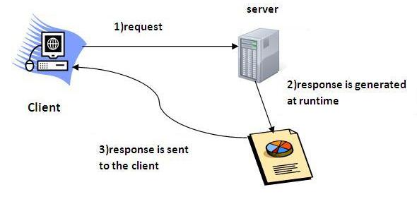

Slide 134
What is web application?
A web application is an application accessible from the web.
A web application is composed of web components like Servlet, JSP, Filter etc. and other components such as HTML.
The web components typically execute in Web Server and respond to HTTP request.

Slide 135
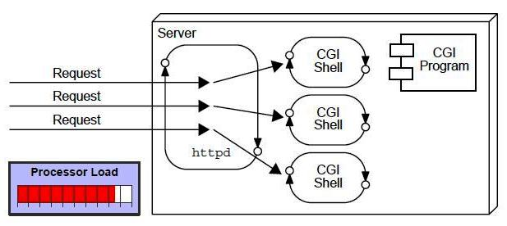
CGI(Commmon Gateway Interface)
CGI technology enables the web server to call an external program and pass HTTP request information to the external program to process the request. For each request, it starts a new process.

Slide 136
Disadvantages of CGI
There are many problems in CGI technology:
If number of clients increases, it takes more time for sending response.
For each request, it starts a process and Web server is limited to start processes.
It uses platform dependent language e.g. C, C++, perl.

Slide 137
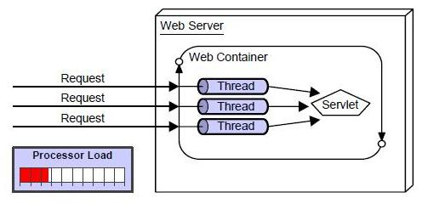
Advantage of Servlet

Slide 138
There are many advantages of servlet over CGI. The web container creates threads for handling the multiple requests to the servlet.
Threads have a lot of benefits over the Processes such as they share a common memory area, lightweight, cost of communication between the threads are low. The basic benefits of servlet are as follows:
better performance: because it creates a thread for each request not process.
Portability: because it uses java language.
Robust: Servlets are managed by JVM so we don't need to worry about memory leak, garbage collection etc.
Secure: because it uses java language..

Slide 139
Web Terminology
Servlet Terminology | Description
Website: static vs dynamic | It is a collection of related web pages that may contain text, images, audio and video.
HTTP | It is the data communication protocol used to establish communication between client and server.
HTTP Requests | It is the request send by the computer to a web server that contains all sorts of potentially interesting information.
Get vs Post | It give the difference between GET and POST request.
Container | It is used in java for dynamically generate the web pages on the server side.
Server: Web vs Application | It is used to manage the network resources and for running the program or software that provides services.
Content Type | It is HTTP header that provides the description about what are you sending to the browser.

Slide 140
Website
Website is a collection of related web pages that may contain text, images, audio and video.
The first page of a website is called home page. Each website has specific internet address (URL) that you need to enter in your browser to access a website.
Website is hosted on one or more servers and can be accessed by visiting its homepage using a computer network.
A website is managed by its owner that can be an individual, company or an organization.

Slide 141
A website can be of two types:
1.Static Website
Static website is the basic type of website that is easy to create.
You don't need web programming and database design to create a static website. Its web pages are coded in HTML.
2.Dynamic Website
Dynamic website is a collection of dynamic web pages whose content changes dynamically. It accesses content from a database or Content Management System (CMS). Therefore, when you alter or update the content of the database, the content of the website is also altered or updated.
Dynamic website uses client-side scripting or server-side scripting, or both to generate dynamic content.

Slide 142
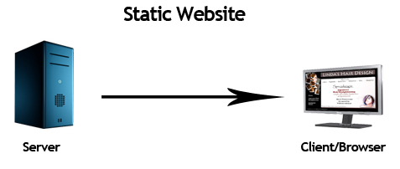
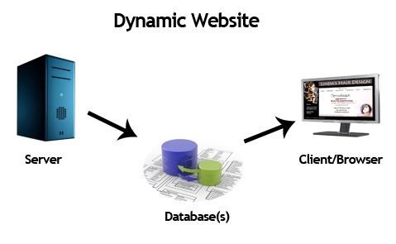

Slide 143
Static Website | Dynamic Website
Prebuilt content is same every time the page is loaded. | Content is generated quickly and changes regularly.
It uses the HTML code for developing a website. | It uses the server side languages such as PHP,SERVLET, JSP, and ASP.NET etc. for developing a website.
It sends exactly the same response for every request. | It may generate different HTML for each of the request.
The content is only changes when someone publishes and updates the file (sends it to the web server). | The page contains "server-side" code it allows the server to generate the unique content when the page is loaded.
Flexibility is the main advantage of static website. | Content Management System (CMS) is the main advantage of dynamic website.

Slide 144
HTTP (Hyper Text Transfer Protocol)
The Hypertext Transfer Protocol (HTTP) is application-level protocol for collaborative, distributed, hypermedia information systems.
It is the data communication protocol used to establish communication between client and server.
HTTP is TCP/IP based communication protocol, which is used to deliver the data like image files, query results, HTML files etc on the World Wide Web (WWW) with the default port is TCP 80.
It provides the standardized way for computers to communicate with each other.

Slide 145
The Basic Characteristics of HTTP (Hyper Text Transfer Protocol):
It is the protocol that allows web servers and browsers to exchange data over the web.
It is a request response protocol.
It uses the reliable TCP connections by default on TCP port 80.
It is stateless means each request is considered as the new request. In other words, server doesn't recognize the user by default.

Slide 146
The Basic Features of HTTP (Hyper Text Transfer Protocol):
There are three fundamental features that make the HTTP a simple and powerful protocol used for communication:
HTTP is media independent: It refers to any type of media content can be sent by HTTP as long as both the server and the client can handle the data content.
HTTP is connectionless: It is a connectionless approach in which HTTP client i.e., a browser initiates the HTTP request and after the request is sends the client disconnects from server and waits for the response.
HTTP is stateless: The client and server are aware of each other during a current request only. Afterwards, both of them forget each other. Due to the stateless nature of protocol, neither the client nor the server can retain the information about different request across the web pages.

Slide 147
HTTP Requests
HTTP Request | Description
GET | Asks to get the resource at the requested URL.
POST | Asks the server to accept the body info attached. It is like GET request with extra info sent with the request.
HEAD | Asks for only the header part of whatever a GET would return. Just like GET but with no body.
TRACE | Asks for the loopback of the request message, for testing or troubleshooting.
PUT | Says to put the enclosed info (the body) at the requested URL.
DELETE | Says to delete the resource at the requested URL.
OPTIONS | Asks for a list of the HTTP methods to which the thing at the request URL can respond

Slide 148
GET and POST
Two common methods for the request-response between a server and client are:
GET- It requests the data from a specified resource
POST- It submits the processed data to a specified resource

Slide 149
Get vs. Post
GET | POST
1) In case of Get request, only limited amount of data can be sent because data is sent in header. | In case of post request, large amount of data can be sent because data is sent in body.
2) Get request is not secured because data is exposed in URL bar. | Post request is secured because data is not exposed in URL bar.
3) Get request can be bookmarked. | Post request cannot be bookmarked.
4) Get request is idempotent . It means second request will be ignored until response of first request is delivered | Post request is non-idempotent.
5) Get request is more efficient and used more than Post. | Post request is less efficient and used less than get.

Slide 150
Anatomy of Get Request
The query string (name/value pairs) is sent inside the URL of a GET request:
GET /RegisterDao.jsp?name1=value1&name2=value2
Anatomy of Post Request
The query string (name/value pairs) is sent in HTTP message body for a POST request:
POST/RegisterDao.jsp HTTP/1.1
Host: www. javatpoint.com
name1=value1&name2=value2

Slide 151
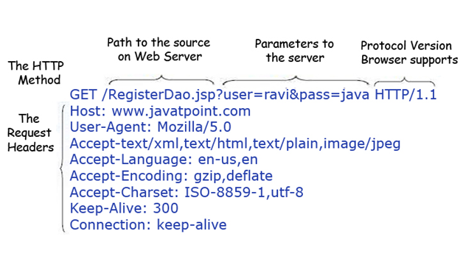
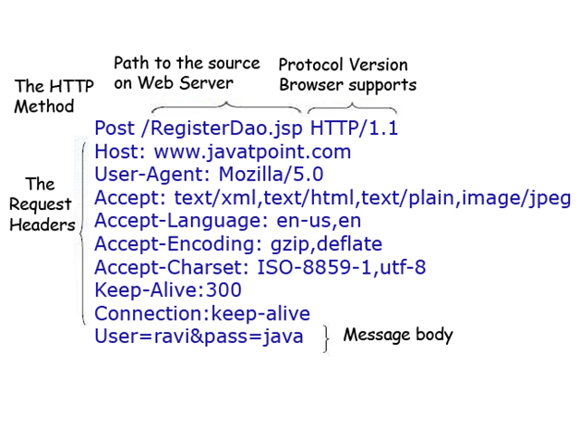

Slide 152
Servlet Container
It provides the runtime environment for JavaEE (j2ee) applications. The client/user can request only a static WebPages from the server. If the user wants to read the web pages as per input then the servlet container is used in java.
The servlet container is used in java for dynamically generate the web pages on the server side. Therefore the servlet container is the part of a web server that interacts with the servlet for handling the dynamic web pages from the client.

Slide 153
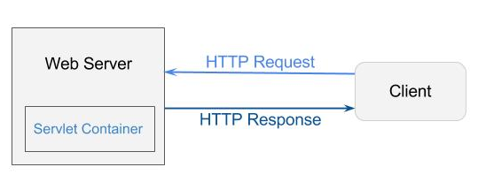
Servlet Container States
The servlet container is the part of web server which can be run in a separate process. We can classify the servlet container states in three types:
Standalone: It is typical Java-based servers in which the servlet container and the web servers are the integral part of a single program. For example:- Tomcat running by itself
In-process: It is separated from the web server, because a different program is runs within the address space of the main server as a plug-in. For example:- Tomcat running inside the JBoss.
Out-of-process: The web server and servlet container are different programs which are run in a different process. For performing the communications between them, web server uses the plug-in provided by the servlet container.

Slide 154
Servlet API
The javax.servlet and javax.servlet.http packages represent interfaces and classes for servlet api.
The javax.servlet package contains many interfaces and classes that are used by the servlet or web container. These are not specific to any protocol.
The javax.servlet.http package contains interfaces and classes that are responsible for http requests only.

Slide 155
Interfaces in javax.servlet package
There are many interfaces in javax.servlet package. They are as follows:
Servlet
ServletRequest
ServletResponse
RequestDispatcher
ServletConfig
ServletContext
SingleThreadModel
Filter
FilterConfig
FilterChain
ServletRequestListener
ServletRequestAttributeListener
ServletContextListener
ServletContextAttributeListener

Slide 156
Classes in javax.servlet package
There are many classes in javax.servlet package. They are as follows:
GenericServlet
ServletInputStream
ServletOutputStream
ServletRequestWrapper
ServletResponseWrapper
ServletRequestEvent
ServletContextEvent
ServletRequestAttributeEvent
ServletContextAttributeEvent
ServletException
UnavailableException

Slide 157
Interfaces in javax.servlet.http package
There are many interfaces in javax.servlet.http package. They are as follows:
HttpServletRequest
HttpServletResponse
HttpSession
HttpSessionListener
HttpSessionAttributeListener
HttpSessionBindingListener
HttpSessionActivationListener
HttpSessionContext (deprecated now)

Slide 158
Classes in javax.servlet.http package
There are many classes in javax.servlet.http package. They are as follows:
HttpServlet
Cookie
HttpServletRequestWrapper
HttpServletResponseWrapper
HttpSessionEvent
HttpSessionBindingEvent
HttpUtils (deprecated now)

Slide 159
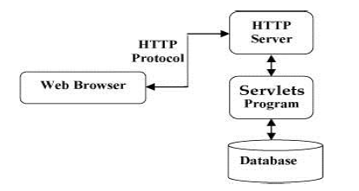
Servlets Architecture:

Slide 160
Servlets Tasks:
Servlets perform the following major tasks:
Read the explicit data sent by the clients (browsers). This includes an HTML form on a Web page or it could also come from an applet or a custom HTTP client program.
Read the implicit HTTP request data sent by the clients (browsers). This includes cookies, media types and compression schemes the browser understands, and so forth.
Process the data and generate the results.
This process may require talking to a database,
executing an RMI or CORBA call, invoking a Web service, or computing the response directly.

Slide 161
Send the explicit data (i.e., the document) to the clients (browsers).
This document can be sent in a variety of formats, including text (HTML or XML), binary (GIF images), Excel, etc.
Send the implicit HTTP response to the clients (browsers). This includes telling the browsers or other clients what type of document is being returned (e.g., HTML), setting cookies and caching parameters, and other such tasks.

Slide 162
Servlet Interface
Servlet interface provides common behaviour to all the servlets.
Servlet interface needs to be implemented for creating any servlet (either directly or indirectly).
It provides 3 life cycle methods that are used
1.to initialize the servlet,
2. to service the requests, and
3.to destroy the servlet and 2 non-life cycle methods.

Slide 163
Methods of Servlet interface
There are 5 methods in Servlet interface. The init, service and destroy are the life cycle methods of servlet. These are invoked by the web container.
Method | Description
public void init(ServletConfig config) | initializes the servlet. It is the life cycle method of servlet and invoked by the web container only once.
public void service(ServletRequest request,ServletResponse response) | provides response for the incoming request. It is invoked at each request by the web container.
public void destroy() | It is invoked only once and indicates that servlet is being destroyed.
public ServletConfig getServletConfig() | returns the object of ServletConfig.
public String getServletInfo() | returns information about servlet such as writer, copyright, version etc.

Slide 164
Servlet Example by implementing Servlet interface
import java.io.*;
import javax.servlet.*;
public class First implements Servlet{
ServletConfig config=null;
public void init(ServletConfig config){
this.config=config;
System.out.println("servlet is initialized");
}
public void service(ServletRequest req,ServletResponse res)
throws IOException,ServletException{
res.setContentType("text/html");
PrintWriter out=res.getWriter();
out.print("<html><body>");
out.print("<b>hello simple servlet</b>");
out.print("</body></html>");

Slide 165
}
public void destroy(){System.out.println("servlet is destroyed");}
public ServletConfig getServletConfig(){return config;}
public String getServletInfo(){return "copyright 2007-1010";}
}

Slide 166
GenericServlet class
GenericServlet class implements Servlet, ServletConfig and Serializable
interfaces. It provides the implementation of all the methods of these interfaces except the service method.
GenericServlet class can handle any type of request so it is protocol-independent.

Slide 167
Methods of GenericServlet class
There are many methods in GenericServlet class. They are as follows:
public void init(ServletConfig config) is used to initialize the servlet.
public abstract void service(ServletRequest request, ServletResponse response) provides service for the incoming request. It is invoked at each time when user requests for a servlet.
public void destroy() is invoked only once throughout the life cycle and indicates that servlet is being destroyed.
public ServletConfig getServletConfig() returns the object of ServletConfig.
public String getServletInfo() returns information about servlet such as writer, copyright, version etc.
public void init() it is a convenient method for the servlet programmers, now there is no need to call super.init(config)

Slide 168
HttpServlet class
The HttpServlet class extends the GenericServlet class and implements Serializable interface. It provides http specific methods such as doGet, doPost, doHead, doTrace etc.

Slide 169
Methods of HttpServlet class
There are many methods in HttpServlet class. They are as follows:
public void service(ServletRequest req,ServletResponse res) dispatches the request to the protected service method by converting the request and response object into http type.
protected void service(HttpServletRequest req, HttpServletResponse res) receives the request from the service method, and dispatches the request to the doXXX() method depending on the incoming http request type.
protected void doGet(HttpServletRequest req, HttpServletResponse res) handles the GET request. It is invoked by the web container.
protected void doPost(HttpServletRequest req, HttpServletResponse res) handles the POST request. It is invoked by the web container.
protected void doHead(HttpServletRequest req, HttpServletResponse res) handles the HEAD request. It is invoked by the web container.
protected void doOptions(HttpServletRequest req, HttpServletResponse res) handles the OPTIONS request. It is invoked by the web container.

Slide 170
Life Cycle of a Servlet (Servlet Life Cycle)
Servlet class is loaded.
Servlet instance is created.
init method is invoked.
service method is invoked.
destroy method is invoked.

Slide 171
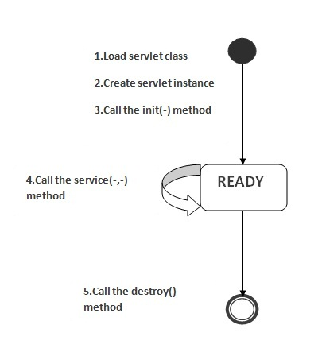

Slide 172
1) Servlet class is loaded
The classloader is responsible to load the servlet class. The servlet class is loaded when the first request for the servlet is received by the web container.
2) Servlet instance is created
The web container creates the instance of a servlet after loading the servlet class. The servlet instance is created only once in the servlet life cycle.
3) init method is invoked
The web container calls the init method only once after creating the servlet instance. The init method is used to initialize the servlet. It is the life cycle method of the javax.servlet.Servlet interface. Syntax of the init method is given below:
public void init(ServletConfig config) throws ServletException

Slide 173
4) service method is invoked
The web container calls the service method each time when request for the servlet is received. If servlet is not initialized, it follows the first three steps as described above then calls the service method. If servlet is initialized, it calls the service method. Notice that servlet is initialized only once. The syntax of the service method of the Servlet interface is given below:
public void service(ServletRequest request, ServletResponse response) throws ServletException, IOException
5) destroy method is invoked
The web container calls the destroy method before removing the servlet instance from the service. It gives the servlet an opportunity to clean up any resource for example memory, thread etc. The syntax of the destroy method of the Servlet interface is given below:
public void destroy()

Slide 174
GET Method and POST Method.
when you need to pass some information from your browser to web server and ultimately to your backend program.
The browser uses two methods to pass this information to web server. These methods are GET Method and POST Method.

Slide 175
GET
The GET type request is normally used for simple HTML page requests. It has this syntax:
public void doGet(HttpServletRequest request, HttpServletResponse response) throws IOException, ServletException { //your code here}
POST
The POST type request is most often used by HTML forms. It has this syntax:
public void doPost(HttpServletRequest request, HttpServletResponse response) throws IOException, ServletException { //your code here}

Slide 176
Form-Data Submission Methods: GET|POST
Two request methods, GET and POST, are available for submitting form data, to be specified in the <form>'s attribute "method=GET|POST".
GET and POST performs the same basic function.
However, in a GET request, the query string is appended behind the URL, separated by a '?'. Whereas in a POST request, the query string is kept in the request body (and not shown in the URL).

Slide 177
The length of query string in a GET request is limited by the maximum length of URL permitted, whereas it is unlimited in a POST request.
I recommend POST request for production.
To try out the POST request, modify the "form_input.html":
<form method="post" action="echo">
......
</form>

Slide 178
public class MyServlet extends HttpServlet {
// doGet() handles GET request
@Override public void doGet(HttpServletRequest request, HttpServletResponse response)
throws IOException, ServletException
{
......
......
}
// doPost() handles POST request
@Override public void doPost(HttpServletRequest request, HttpServletResponse response)
throws IOException, ServletException
{
doGet(request, response);
// call doGet()
}
}

Slide 179
Request Header and Response Header
HTTP is a request-response protocol.
The client sends a request message to the server.
The server, in turn, returns a response message.
The request and response messages consists of two parts: header (information about the message) and body (contents).
Header provides information about the messages. The data in header is organized in name-value pairs.
Read "HTTP Request and Response Messages" for the format, syntax of request and response messages.

Slide 180
HttpServletRequest
The request message is encapsulated in an HttpServletRequest object, which is passed into the doGet() methods.
HttpServletRequest provides many methods for you to retrieve the headers:
General methods:
getHeader(name), getHeaders(name), getHeaderNames().
Specific methods:
getContentLength(), getContentType(), getCookies(), getAuthType(), etc.
URL related:
getRequestURI(), getQueryString(), getProtocol(), getMethod().

Slide 181
HttpServletResponse
The response message is encapsulated in the HttpServletResponse, which is passed into doGet() by reference for receiving the servlet output.
setStatusCode(int statuscode), sendError(int code, String message), sendRedirect(url).
response.setHeader(String headerName, String headerValue).
setContentType(String mimeType), setContentLength(int length), etc.

Slide 182
Session Tracking
HTTP is a stateless protocol.
In other words, the current request does not know what has been done in the previous requests.
This creates a problem for applications that runs over many requests, such as online shopping (or shopping cart). You need to maintain a so-called session to pass data among the multiple requests.
You can maintain a session via one of these three approaches:
Cookie: A cookie is a small text file that is stored in the client's machine, which will be send to the server on each request. You can put your session data inside the cookie. The biggest problem in using cookie is clients may disable the cookie.

Slide 183
URL Rewriting: Passes data by appending a short text string at the end of every URL, e.g., http://host/path/file.html;jsessionid=123456. You need to rewrite all the URLs (e.g., the "action" attribute of <form>) to include the session data.
Hidden field in an HTML form: pass data by using hidden field tag (<input type="hidden" name="session" value="...." />). Again, you need to include the hidden field in all the pages.

Slide 184
Session Tracking in Servlets
Session simply means a particular interval of time.
Session Tracking is a way to maintain state (data) of an user. It is also known as session management in servlet.
Http protocol is a stateless so we need to maintain state using session tracking techniques. Each time user requests to the server, server treats the request as the new request. So we need to maintain the state of an user to recognize to particular user.

Slide 185
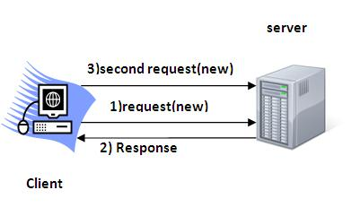
Why use Session Tracking?
To recognize the user It is used to recognize the particular user.

Slide 186
Session Tracking Techniques
There are four techniques used in Session tracking:
Cookies
Hidden Form Field
URL Rewriting
HttpSession

Slide 187
Cookies in Servlet
A cookie is a small piece of information that is persisted between the multiple client requests.
A cookie has a name, a single value, and optional attributes such as a comment, path and domain qualifiers, a maximum age, and a version number.

Slide 188
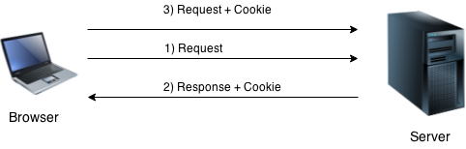
How Cookie works
By default, each request is considered as a new request.
In cookies technique, we add cookie with response from the servlet. So cookie is stored in the cache of the browser. After that if request is sent by the user, cookie is added with request by default. Thus, we recognize the user as the old user.

Slide 189
Types of Cookie
There are 2 types of cookies in servlets.
1.Non-persistent cookie
2.Persistent cookie
Non-persistent cookie
It is valid for single session only. It is removed each time when user closes the browser.
Persistent cookie
It is valid for multiple session . It is not removed each time when user closes the browser. It is removed only if user logout or signout.

Slide 190
Advantage of Cookies
Simplest technique of maintaining the state.
Cookies are maintained at client side.
Disadvantage of Cookies
It will not work if cookie is disabled from the browser.
Only textual information can be set in Cookie object.

Slide 191
Cookie class javax.servlet.http.Cookie class provides the functionality of using cookies. It provides a lot of useful methods for cookies.
Constructor of Cookie class
Constructor | Description
Cookie() | constructs a cookie.
Cookie(String name, String value) | constructs a cookie with a specified name and value.

Slide 192
Useful Methods of Cookie class
Method | Description
public void setMaxAge(int expiry) | Sets the maximum age of the cookie in seconds.
public String getName() | Returns the name of the cookie. The name cannot be changed after creation.
public String getValue() | Returns the value of the cookie.
public void setName(String name) | changes the name of the cookie.
public void setValue(String value) | changes the value of the cookie.

Slide 193
How to create Cookie?
Let's see the simple code to create cookie.
Cookie ck=new Cookie("user","sonoo jaiswal");//creating cookie object
response.addCookie(ck);//adding cookie in the response
How to delete Cookie?
Let's see the simple code to delete cookie. It is mainly used to logout or signout the user.
Cookie ck=new Cookie("user","");//deleting value of cookie
ck.setMaxAge(0);//changing the maximum age to 0 seconds
response.addCookie(ck);//adding cookie in the response

Slide 194
How to get Cookies?
Let's see the simple code to get all the cookies.
Cookie ck[]=request.getCookies();
for(int i=0;i<ck.length;i++){
out.print("<br>"+ck[i].getName()+" "+ck[i].getValue
());//printing name and value of cookie
}

Slide 195
2) Hidden Form Field
In case of Hidden Form Field a hidden (invisible) textfield is used for maintaining the state of an user.
In such case, we store the information in the hidden field and get it from another servlet. This approach is better if we have to submit form in all the pages and we don't want to depend on the browser.
<input type="hidden" name="uname" value="Vimal Jaiswal">
Here, uname is the hidden field name and Vimal Jaiswal is the hidden field value.

Slide 196
Advantage of Hidden Form Field
It will always work whether cookie is disabled or not.
Disadvantage of Hidden Form Field:
It is maintained at server side.
Extra form submission is required on each pages.
Only textual information can be used.

Slide 197
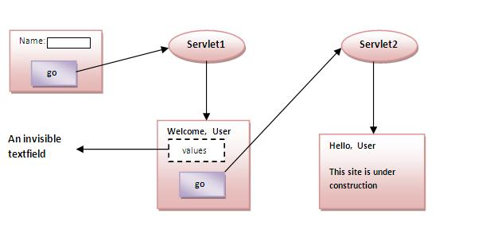
Example of using Hidden Form Field In this example, we are storing the name of the user in a hidden textfield and getting that value from another servlet.
<form action="servlet1">
Name:<input type="text" name="userName"/><br/>
<input type="submit" value="go"/>
</form>

Slide 198
3)URL Rewriting
In URL rewriting, we append a token or identifier to the URL of the next Servlet or the next resource. We can send parameter name/value pairs using the following format:
url?name1=value1&name2=value2&??
A name and a value is separated using an equal = sign, a parameter name/value pair is separated from another parameter using the ampersand(&). When the user clicks the hyperlink, the parameter name/value pairs will be passed to the server.
From a Servlet, we can use getParameter() method to obtain a parameter value.

Slide 199
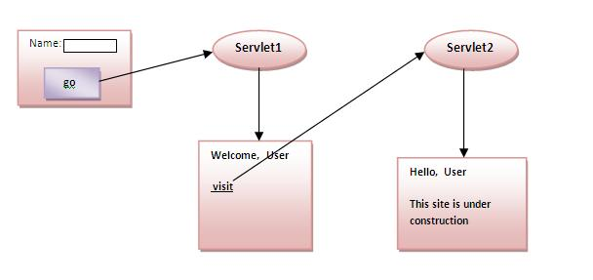
Advantage of URL Rewriting
It will always work whether cookie is disabled or not (browser independent).
Extra form submission is not required on each pages.
Disadvantage of URL Rewriting
It will work only with links.
It can send Only textual information.

Slide 200
4) HttpSession interface
In such case, container creates a session id for each user.The container uses this id to identify the particular user.An object of HttpSession can be used to perform two tasks:
1.bind objects
2.view and manipulate information about a session, such as the session identifier, creation time, and last accessed time.

Slide 201
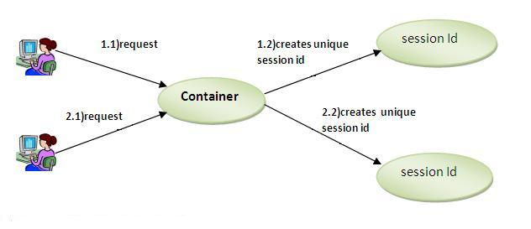

Slide 202
How to get the HttpSession object ?
The HttpServletRequest interface provides two methods to get the object of HttpSession:
public HttpSession getSession():Returns the current session associated with this request, or if the request does not have a session, creates one.
public HttpSession getSession(boolean create):Returns the current HttpSession associated with this request or, if there is no current session and create is true, returns a new session.

Slide 203
Commonly used methods of HttpSession interface
public String getId():Returns a string containing the unique identifier value.
public long getCreationTime():Returns the time when this session was created, measured in milliseconds since midnight January 1, 1970 GMT.
public long getLastAccessedTime():Returns the last time the client sent a request associated with this session, as the number of milliseconds since midnight January 1, 1970 GMT.
public void invalidate():Invalidates this session then unbinds any objects bound to it.

Slide 204
JDBC
JAVA DATABASE CONNECTIVITY
IMPORT THE PACAKAGE(JAVA.SQL.*)
LOAD & REGISTER THE DRIVER
ESTABLISH THE CONNECTION---CREATE AN OBJECT
CREATE THE STATEMENT
-STATEMENT
-PREPARED STATEMENT
-CALLABLE STATEMENT
5.EXECUTE THE QUERY
6.PROCESS THE RESULT
7.CLOSE DATABASE

Slide 205
EXAMPLE
Import java.sql.*;
Public static void main()
{ class.forName(“con.mysql.jdbc.driver”);
Connection con=Driver manager.getConnection(“url”,”uid”,”pwd”);
Statement st= con.create Statement();
ResultSet=st.executeQuery(“Select * from student”);
while(rs.next())
System.out.println(rs.getInt(1)+” “+rs.Student(2)}
St.close();con.close();

Slide 206
Java JDBC
Java JDBC is a java API to connect and execute query with the database. JDBC API uses jdbc drivers to connect with the database.
Why use JDBC?
What is API ?
API (Application programming interface) is a document that contains description of all the features of a product or software. It represents classes and interfaces that software programs can follow to communicate with each other. An API can be created for applications, libraries, operating systems, etc

Slide 207
Introduction
JDBC stands for Java Database Connectivity, which is a standard Java API for database-independent connectivity between the Java programming language and a wide range of databases.
The JDBC library includes APIs for each of the tasks commonly associated with database usage:
Making a connection to a database
Creating SQL or MySQL statements
Executing that SQL or MySQL queries in the database
Viewing & Modifying the resulting records
Fundamentally, JDBC is a specification that provides a complete set of interfaces that allows for portable access to an underlying database. Java can be used to write different types of executables, such as: Java Applications
Java Applets
Java Servlets
Java Server Pages (JSPs)
Enterprise JavaBeans (EJBs)

Slide 208
All of these different executables are able to use a JDBC driver to access a database and take advantage of the stored data.
JDBC provides the same capabilities as ODBC, allowing Java programs to contain database-independent code.
Cont..
JDBC Architecture
The JDBC API supports both two-tier and three-tier processing models for database access but in general JDBC Architecture consists of two layers:
JDBC API: This provides the application-to-JDBC Manager connection. (java.sql / javax.sql)
JDBC Driver API: This supports the JDBC Manager-to-Driver Connection.

Slide 209
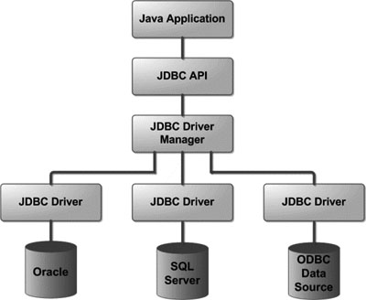
Cont..
Following is the architectural diagram, which shows the location of the driver manager with respect to the JDBC drivers and the Java application:

Slide 210
Cont..
Common JDBC Components:
The JDBC API provides the following interfaces and classes:
DriverManager: This class manages a list of database drivers. Matches connection requests from the java application with the proper database driver using communication sub protocol. The first driver that recognizes a certain sub protocol under JDBC will be used to establish a database Connection.
Driver: This interface handles the communications with the database server. You will interact directly with Driver objects very rarely. Instead, you use DriverManager objects, which manage objects of this type. It also abstracts the details associated with working with Driver objects.
Connection: This interface provides all methods for contacting a database. The connection object represents communication context, i.e., all communication with database is through connection object only.

Slide 211
Cont..
Statement: You use objects created from this interface to submit the SQL statements to the database.
ResultSet: These objects hold data retrieved from a database after you execute an SQL query using Statement objects. It acts as an iterator to allow you to move through its data.
SQLException: This class handles any errors that occur in a database application.

Slide 212
5 Steps to connect to the database in java
There are 5 steps to connect any java application with the database in java using JDBC. They are as follows:
Register the driver class
Creating connection
Creating statement
Executing queries
Closing connection

Slide 213
1) Register the driver class
The forName() method of Class class is used to register the driver class. This method is used to dynamically load the driver class.
Syntax of forName() method
public static void forName(String className)throws ClassNotFoundException
Example to register the OracleDriver class
Class.forName("oracle.jdbc.driver.OracleDriver");

Slide 214
2) Create the connection object
The getConnection() method of DriverManager class is used to establish connection with the database.
Syntax of getConnection() method
1) public static Connection getConnection(String url)
throws SQLException
2) public static Connection getConnection(String url,
String name,String password)throws SQLException
Example to establish connection with the Oracle database
Connection con=DriverManager.getConnection
("jdbc:oracle:thin:@localhost:1521:xe","system","password");

Slide 215
3) Create the Statement object
The createStatement() method of Connection interface is used to create statement. The object of statement is responsible to execute queries with the database.
Syntax of createStatement() method
public Statement createStatement()throws SQLException
Example to create the statement object
Statement stmt=con.createStatement();

Slide 216
4) Execute the query
The executeQuery() method of Statement interface is used to execute queries to the database. This method returns the object of ResultSet that can be used to get all the records of a table.
Syntax of executeQuery() method
public ResultSet executeQuery(String sql)throws
SQLException
Example to execute query
ResultSet rs=stmt.executeQuery("select * from emp"); while(rs.next())
{
System.out.println(rs.getInt(1)+" "+rs.getString(2));
}

Slide 217
5) Close the connection object
By closing connection object statement and ResultSet will be closed automatically. The close() method of Connection interface is used to close the connection.
Syntax of close() method
public void close()throws SQLException
Example to close connection
con.close();

Slide 218
Example to connect to the Oracle database in java
1.Driver class: The driver class for the oracle database is oracle.jdbc.driver.OracleDriver.
2.Connection URL: The connection URL for the oracle10G database is jdbc:oracle:thin:@localhost:1521:xe where jdbc is the API, oracle is the database, thin is the driver, localhost is the server name on which oracle is running, we may also use IP address, 1521 is the port number and XE is the Oracle service name. You may get all these information from the tnsnames.ora file.
3.Username: The default username for the oracle database is system.
4.Password: Password is given by the user at the time of installing the oracle database.
Let's first create a table in oracle database.
create table emp(id number(10),name varchar2(40),age number(3));

Slide 219
Example to Connect Java Application with Oracle database
In this example, system is the username and oracle is the password of the Oracle database.
import java.sql.*;
class OracleCon{
public static void main(String args[]){
try{
1.//step1 load the driver class
Class.forName("oracle.jdbc.driver.OracleDriver");
2.//step2 create the connection object
Connection con=DriverManager.getConnection(
"jdbc:oracle:thin:@localhost:1521:xe","system","oracle");

Slide 220
3.//step3 create the statement object
Statement stmt=con.createStatement();
4.//step4 execute query
ResultSet rs=stmt.executeQuery("select * from emp");
while(rs.next())
System.out.println(rs.getInt(1)+" "+rs.getString(2)+" "+rs.getString(3));
5.//step5 close the connection object
con.close();
}
catch(Exception e){ System.out.println(e);}
}
}

Slide 221
Example to connect to the mysql database in java
1.Driver class: The driver class for the mysql database is com.mysql.jdbc.Driver.
2.Connection URL: The connection URL for the mysql database is jdbc:mysql://localhost:3306/sonoo where jdbc is the API, mysql is the database, localhost is the server name on which mysql is running, we may also use IP address, 3306 is the port number and sonoo is the database name. We may use any database, in such case, you need to replace the sonoo with your database name.
3.Username: The default username for the mysql database is root.
4.Password: Password is given by the user at the time of installing the mysql database. In this example, we are going to use root as the password.
Let's first create a table in the mysql database, but before creating table, we need to create database first.
create database sonoo;
use sonoo;
create table emp(id int(10),name varchar(40),age int(3));

Slide 222
import java.sql.*;
class MysqlCon{
public static void main(String args[]){
try{
1.Class.forName("com.mysql.jdbc.Driver");
2.Connection con=DriverManager.getConnection(
"jdbc:mysql://localhost:3306/sonoo","root","root");
//here sonoo is database name, root is username and password
3.Statement stmt=con.createStatement();
4.ResultSet rs=stmt.executeQuery("select * from emp");
while(rs.next())
System.out.println(rs.getInt(1)+" "+rs.getString(2)+" "+rs.getString(3));
5.con.close();
}catch(Exception e){ System.out.println(e);}
}
}

Slide 223
Database Drivers
JDBC drivers implement the defined interfaces in the JDBC API for interacting with your database server.
For example, using JDBC drivers enable you to open database connections and to interact with it by sending SQL or database commands then receiving results with Java.
The Java.sql package that ships with JDK contains various classes with their behaviors defined and their actual implementations are done in third-party drivers. Third party vendors implement the java.sql.Driver interface in their database driver.

Slide 224
Cont..
JDBC Drivers Types
JDBC driver implementations vary because of the wide variety of operating systems and hardware platforms in which Java operates. Sun has divided the implementation types into four categories, Types 1, 2, 3, and 4, which is explained below:
Type 1: JDBC-ODBC Bridge Driver:
In a Type 1 driver, a JDBC bridge is used to access ODBC drivers installed on each client machine. Using ODBC requires configuring on your system a Data Source Name (DSN) that represents the target database.
When Java first came out, this was a useful driver because most databases only supported ODBC access but now this type of driver is recommended only for experimental use or when no other alternative is available.
The JDBC-ODBC bridge that comes with JDK 1.2 is a good example of this kind of driver.

Slide 225
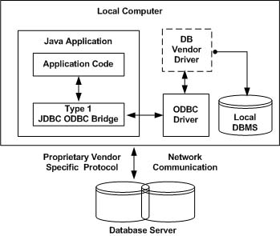
Cont..
Figure Type 1: JDBC-ODBC Bridge Driver

Slide 226
Data Source
Java Application
JDBC API
JDBC ODBC Bridge
ODBC API
ODBC Layer
Figure Type 1: JDBC-ODBC Bridge Driver

Slide 227
Cont..
Type 2: JDBC-Native API
In a Type 2 driver, JDBC API calls are converted into native C/C++ API calls which are unique to the database. These drivers typically provided by the database vendors and used in the same manner as the JDBC-ODBC Bridge, the vendor-specific driver must be installed on each client machine.
If we change the Database we have to change the native API as it is specific to a database and they are mostly obsolete now but you may realize some speed increase with a Type 2 driver, because it eliminates ODBC's overhead.
The Oracle Call Interface (OCI) diver is an example of a Type 2 driver.

Slide 228
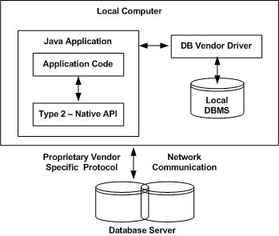
Cont..
Figure Type 2: JDBC-Native API

Slide 229
Data Source
Java Application
JDBC API
JDBC Driver
Vendor Specific API
Figure Type 2: JDBC-Native API

Slide 230
Cont..
Type 3: JDBC-Part Java
In a Type 3 driver, a three-tier approach is used to accessing databases. The JDBC clients use standard network sockets to communicate with a middleware application server. The socket information is then translated by the middleware application server into the call format required by the DBMS, and forwarded to the database server.
This kind of driver is extremely flexible, since it requires no code installed on the client and a single driver can actually provide access to multiple databases.
You can think of the application server as a JDBC "proxy," meaning that it makes calls for the client application. As a result, you need some knowledge of the application server's configuration in order to effectively use this driver type.
Your application server might use a Type 1, 2, or 4 driver to communicate with the database, understanding the nuances will prove helpful.

Slide 231
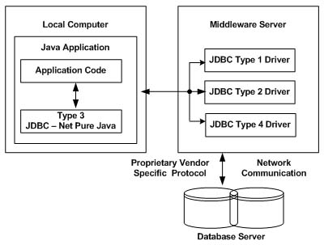
Cont..
Figure Type 3: JDBC-Part Java

Slide 232
Data Source
Java Application
JDBC API
JDBC Driver
JDBC Driver Server
Native Driver
Figure Type 3: JDBC-Part Java

Slide 233
What does IDS Server do?
IDS Server is an internet database access server (or middleware) that allows you to create Web applications that can interact with your backend DBMS. IDS Server offers two ways of doing this: (a) You can embed special tags in a normal HTML document which the IDS Server will recognize and process, then return database query results in a Web page that can be view by your browser. We call this technology IDS HTML Extensions. (b) IDS Server includes IDS JDBC Driver, a Type-3 JDBC driver that will enable you to write and deploy Java applets and programs using the JDBC API to perform database operations.

Slide 234
Cont..
Type 4: 100% pure Java
In a Type 4 driver, a pure Java-based driver that communicates directly with vendor's database through socket connection. This is the highest performance driver available for the database and is usually provided by the vendor itself.
This kind of driver is extremely flexible, you don't need to install special software on the client or server. Further, these drivers can be downloaded dynamically.
MySQL's Connector/J driver is a Type 4 driver. Because of the proprietary nature of their network protocols, database vendors usually supply type 4 drivers.

Slide 235
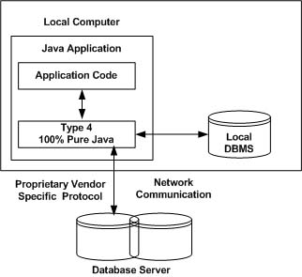
Cont..
Figure Type 4: 100% pure Java

Slide 236
Data Source
Java Application
JDBC API
JDBC Driver
Figure Type 4: 100% pure Java

Slide 237
Cont..
Which Driver should be used?
If you are accessing one type of database, such as Oracle, Sybase, or IBM, the preferred driver type is 4.
If your Java application is accessing multiple types of databases at the same time, type 3 is the preferred driver.
Type 2 drivers are useful in situations where a type 3 or type 4 driver is not available yet for your database.
The type 1 driver is not considered a deployment-level driver and is typically used for development and testing purposes only.

Slide 238
Connection:
The connection to the database is established by using one of three getConnection()methods of the DriverManager object. The getConnection() method requests access to the database from the DBMS. It is up to the DBMS to grant or reject access. Aconnection object is returned by the getConnection() method if access is granted, otherwise the getConnection() method throws an SQLException.
Sometimes the DBMS grants access to a database to anyone. In this case, the J2ME application uses the getConnection(String url) method. One parameter is passed to the method because the DBMS only needs the database identified. This is shown in Listing 10-5.
String url = "jdbc:odbc:CustomerInformation";
Statement DataRequest;
Connection Db;
try {
Class.forName( "sun.jdbc.odbc.JdbcOdbcDriver");
Db = DriverManager.getConnection(url);
}
catch (ClassNotFoundException error) {

Slide 239
System.err.println("Unable to load the JDBC/ODBC bridge." +
error);
System.exit(1);
}
catch (SQLException error) {
System.err.println("Cannot connect to the database." + error);
System.exit(2);
}

Slide 240
Sometimes the DBMS grants access to a database to anyone. In this case, the J2ME application uses the getConnection(String url) method. One parameter is passed to the method because the DBMS only needs the database identified. This is shown in Listing 10-5.
String url = "jdbc:odbc:CustomerInformation";
Statement DataRequest;
Connection Db;
try {
Class.forName( "sun.jdbc.odbc.JdbcOdbcDriver");
Db = DriverManager.getConnection(url);
}
catch (ClassNotFoundException error) {
System.err.println("Unable to load the JDBC/ODBC bridge." +
error);
System.exit(1);
}
catch (SQLException error) {
System.err.println("Cannot connect to the database." + error);
System.exit(2);
}

Slide 241
TIME OUT
multiple applications might attempt to access a database simultaneously. The DBMS may not respond quickly for a number of reasons, one of which might be that database connections are not available. Rather than wait for a delayed response from the DBMS, the J2ME application can set a timeout period after which the Driver Manager will cease trying to connect to the database.
The public static void DriverManager.setLoginTimeout(int seconds) method can be used by the J2ME application to establish the maximum time the DriverManager waits for a response from a DBMS before timing out. Likewise, the public static int DriverManager.getLoginTimeout() method is used to retrieve from the DriverManager the maximum time the DriverManager is set to wait until it times out. The DriverManager.getLoginTimeout() returns an int that represents seconds.

Slide 242
Connection Pool
A connection pool is a collection of database connections that are opened once and loaded into memory so these connections can be reused without having to reconnect to the DBMS.
Clients use the Data Source interface to interact with the
connection pool.
The connection pool itself is implemented by the application server and other J2EE-specific technologies, which hide details on how the connection pool
. There are two types of connections made to the database. The first is the physical connection, which is made by the application server using Pooled Connection objects.
Pooled Connection objects are cached and reused. The other type of connection is the logical connection.

Slide 243
Context ctext = new InitialContext();
DataSource pool = (DataSource) ctext.lookup("java:comp/env/jdbc/pool");
Connection db = pool.getConnection();
// Place code to interact with the database here
db.close();

Slide 244
Statement Objects
Once a connection to the database is opened, the J2ME application creates and sends a
query to access data contained in the database. The query is written using SQL.
One of three types of Statement objects is used to execute the query.
These objects are Statement, which executes a query immediately;
Prepared Statement, which is used to execute a compiled query; and Callable Statement, which is used to execute store procedures.

Slide 245
The Statement Object
The Statement object is used whenever a J2ME application needs to execute a query immediately without first having the query compiled. The Statement object contains the executeQuery() method, which is passed the query as an argument. The query is then transmitted to the DBMS for processing. The executeQuery() method returns one ResultSet object that contains rows, columns, and metadata that represent data requested by the query. The Result Set object also contains methods that are used to manipulate data in the ResultSet.
The execute() method of the Statement object is used when multiple results may be returned. A third commonly used method of the Statement object is the executeUpdate() method. The executeUpdate() method is used to execute queries that contain UPDATE and DELETE SQL statements, which change values in a row and remove a row, respectively. The executeUpdate() method returns an integer indicating the number of rows that were
updated by the query. ExecuteUpdate() is used to INSERT, UPDATE, DELETE, and DDL statements.

Slide 246
String url = "jdbc:odbc:CustomerInformation";
String userID = "jim";
String password = "keogh";
Statement DataRequest;
ResultSet Results;
Connection Db;
try {
Class.forName( "sun.jdbc.odbc.JdbcOdbcDriver");
Db = DriverManager.getConnection(url,userID,password);
}
catch (ClassNotFoundException error) {
System.err.println("Unable to load the JDBC/ODBC bridge." +
error);
System.exit(1);
}
catch (SQLException error) {
System.err.println("Cannot connect to the database." + error);

Slide 247
System.exit(2);
}
try {
String query = "SELECT * FROM Customers";
DataRequest = Db.createStatement();
Results = DataRequest.executeQuery (query);
//Place code here to interact with the ResultSet
DataRequest.close();
}
catch ( SQLException error ){
System.err.println("SQL error." + error);
System.exit(3);
}
Db.close();

Slide 248
Example for executeupdate() method
String url = "jdbc:odbc:CustomerInformation";
String userID = "jim";
String password = "keogh";
Statement DataRequest;
Connection Db;
int rowsUpdated;
try {
Class.forName( "sun.jdbc.odbc.JdbcOdbcDriver");
Db = DriverManager.getConnection(url,userID,password);
}
catch (ClassNotFoundException error) {
System.err.println("Unable to load the JDBC/ODBC bridge." +
error);
System.exit(1);
}

Slide 249
}
catch (SQLException error) {
System.err.println("Cannot connect to the database." + error);
System.exit(2);
}
try {
String query = "UPDATE Customers SET PAID='Y' WHERE BALANCE = '0';
DataRequest = Db.createStatement();
rowsUpdated = DataRequest.executeUpdate (query);
DataRequest.close();
}
catch ( SQLException error ){
System.err.println("SQL error." + error);
System.exit(3);
}
Db.close();

Slide 250
PreparedStatement Object
An SQL query must be compiled before the DBMS processes the query. Compiling occurs after one of the Statement object’s execution methods is called. Compiling a query is an overhead that is acceptable if the query is called once. However, the compiling process can become an expensive overhead if the query is executed several times by the same instance of the J2ME application during the same session.
An SQL query can be precompiled and executed by using the PreparedStatement object. The preparedStatement() method of the Connection object is called to return the PreparedStatement object. The preparedStatement() method is passed the query that is then precompiled. The setXXX() method of the PreparedStatement object is used to replace the question mark with the value passed to the setXXX() method. There are a
number of setXXX() methods available in the PreparedStatement object, each of which specifies the data type of the value that is being passed to the setXXX() method

Slide 251
String url = "jdbc:odbc:CustomerInformation";
String userID = "jim";
String password = "keogh";
ResultSet Results;
Connection Db;
try {
Class.forName( "sun.jdbc.odbc.JdbcOdbcDriver");
Db = DriverManager.getConnection(url,userID,password);
}
catch (ClassNotFoundException error) {
System.err.println(
"Unable to load the JDBC/ODBC bridge." + error);
System.exit(1);
}

Slide 252
catch (SQLException error) {
System.err.println("Cannot connect to the database." + error);
System.exit(2);
}
try {
String query = "SELECT * FROM Customers WHERE CustNumber = ?";
PreparedStatement pstatement = Db.preparedStatement(query);
pstatement.setString(1, "123");
Results = pstatement.executeQuery ();
//Place code here to interact with the ResultSet

Slide 253
pstatement.close();
}
catch ( SQLException error ){
System.err.println("SQL error." + error);
System.exit(3);
}
Db.close();

Slide 254
Callable Statement
The Callable Statement is used to call a stored procedure from within a J2ME object. A
stored procedure is a block of code and is identified by a unique name.
The Callable Statement object uses three types of parameters when calling a stored procedure.
These parameters are IN, OUT, and INOUT.

Slide 255
The IN parameter contains any data that needs to be passed to the stored procedure and whose value is assigned using the setXXX() method.
The OUT parameter contains the value returned by the stored procedures, if any. The OUT parameter must be registered using the registerOutParameter() method .
J2ME application using the getXXX() method. The INOUT parameter is a single parameter used for both passing information to the stored procedure and retrieving information from a stored procedure using the techniques described in the previous two paragraphs.

Slide 256
ResultSet
A query is used to update,delete, and retrieve information stored in a database.
The executeQuery() method is used to send the query to the DBMS for processing and returns a ResultSet object that
contains data requested by the query.
The ResultSet object contains methods that are used to copy data from the ResultSet into a Java collection of objects or variable(s) for further processing.
Data in a ResultSet object is logically organized into a virtual table consisting of rows and columns.
In addition to data, the ResultSet object also contains metadata, such as column names, column size, and column data type.

Slide 257
The ResultSet uses a virtual cursor to point to a row of the virtual table.
A J2ME application must move the virtual cursor to each row, then use other methods of the ResultSet object to interact with the data stored in columns of that row.
The virtual cursor is positioned above the first row of data when the ResultSet is returned by the executeQuery() method.
This means that the virtual cursor must be moved to the first row using the next() method.
The next() method returns a boolean true if the row contains data, otherwise a boolean false is returned, indicating that no more rows exist in the ResultSet.
Columns appear in the ResultSet in the order in which column names appeared in
the SELECT statement in the query.
Let’s say a query contained the following SELECT statement:
SELECT CustomerFirstName, CustomerLastName FROM Customer

Slide 258
READING A RESULT SET
Once a successful connection is made to the database, a query is defined in the second try {} block to retrieve the first name and last name of customers from the Customers table of the CustomerInformation database.
The next() method of the ResultSet is called to move the virtual pointer to the first row in the ResultSet. If there is data in that row, the next() returns a true, which is assigned the boolean variable Records. If there isn’t any data in that row, Records is assigned a false value.
A false value is trapped by the if statement, where the “End of data.” message is displayed and the program terminates. A true value causes the program to enter the do…while in the third try {} block, where the getString() method is called to retrieve values in the first and second columns of the ResultSet. The values correspond to the first name and last name. These values are assigned to their corresponding String object, which is then concatenated and assigned the printrow String object and printed on the screen.

Slide 259
boolean Records = Results.next();
if (!Records ) {
System.out.println("No data returned");
System.exit(4);
}
try {
do {
FirstName = Results.getString ( 1 ) ;
LastName = Results.getString ( 2 ) ;
printrow = FirstName + " " + LastName;
System.out.println(printrow);
} while (Results.next() );
DataRequest.close();

Slide 260
String url = "jdbc:odbc:CustomerInformation";
String userID = "jim";
String password = "keogh";
String printrow;
String FirstName;
String LastName;
Statement DataRequest;
ResultSet Results;
Connection Db;
try {
Class.forName( "sun.jdbc.odbc.JdbcOdbcDriver");
Db = DriverManager.getConnection(url,userID,password);
}
catch (ClassNotFoundException error) {
System.err.println("Unable to load the JDBC/ODBC bridge." +
error);
System.exit(1);

Slide 261
} catch (SQLException error) {
System.err.println("Cannot connect to the database." + error);
System.exit(2);
} try {
String query = "SELECT FirstName,LastName FROM Customers";
DataRequest = Db.createStatement();
Results = DataRequest.executeQuery (query);
}
catch ( SQLException error ){
System.err.println("SQL error." + error);
System.exit(3);
} boolean Records = Results.next();
if (!Records ) {
System.out.println("No data returned");
System.exit(4);
} try { do {
FirstName = Results.getString ( 1 ) ;
LastName = Results.getString ( 2 ) ;
printrow = FirstName + " " + LastName;
System.out.println(printrow);
} while (Results.next() );
DataRequest.close();
} catch (SQLException error ) {
System.err.println("Data display error." + error);
System.exit(5); }

Slide 262
Scrollable ResultSet
Until the release of JDBC 2.1 API, the virtual cursor could only be moved down the
ResultSet object.
But today the virtual cursor can be moved backwards or even positioned
at a specific row.
The JDBC 2.1 API also enables a J2ME application to specify the number
of rows to return from the DBMS.
Six methods of the ResultSet object are used to position the virtual cursor, in addition to the next() method discussed in the previous section.
These are first(), last(), previous(), absolute(), relative(), and getRow().
The first() method moves the virtual cursor to the first row in the ResultSet. Likewise, the last() method positions the virtual cursor at the last row in the ResultSet.
The previous() method moves the virtual cursor to the previous row.
The absolute() method positions the virtual cursor at the row number specified by the integer passed as a parameter to the absolute() method.

Slide 263
The relative() method moves the virtual cursor the specified number of rows contained in the parameter.
The parameter is a positive or negative integer, where the sign represents
the direction the virtual cursor is moved.
For example, a –4 moves the virtual cursor back four rows from the current row. Likewise, a 5 moves the virtual cursor forward five rows from the current row.
And the getRow() method returns an integer that represents the number of the current row in the ResultSet.
The Statement object that is created using the createStatement() of the Connection object must be set up to handle a scrollable ResultSet by passing the createStatement() method one of three constants.
These constants are TYPE_FORWARD_ONLY, TYPE_SCROLL_INSENSITIVE, and TYPE_SCROLL_SENSITIVE.

Slide 264
The TYPE_FORWARD_ONLY constant restricts the virtual cursor to downward
movement, which is the default setting. TYPE_SCROLL_INSENSITIVE and TYPE_
SCROLL_SENSITIVE constants permit the virtual cursor to move in both directions.
TYPE_SCROLL_INSENSITIVE makes the ResultSet insensitive to data changes made by
another J2ME application in the table whose rows are reflected in the ResultSet. The
TYPE_SCROLL_SENSITIVE constant makes the ResultSet sensitive to those changes.
String url = "jdbc:odbc:CustomerInformation";
String userID = "jim";
String password = "keogh";
String printrow;
String FirstName;
String LastName;
Statement DataRequest;

Slide 265
ResultSet Results;
Connection Db;
try {
Class.forName( "sun.jdbc.odbc.JdbcOdbcDriver");
Db = DriverManager.getConnection(url,userID,password);
}
catch (ClassNotFoundException error) {
System.err.println("Unable to load the JDBC/ODBC bridge." +
error);
System.exit(1);
}
catch (SQLException error) {
System.err.println("Cannot connect to the database." + error);
System.exit(2);
}
try {
String query = "SELECT FirstName,LastName FROM Customers";
DataRequest = Db.createStatement(TYPE_SCROLL_INSENSITIVE);
Results = DataRequest.executeQuery (query);
}
catch ( SQLException error ){
System.err.println("SQL error." + error);
System.exit(3);

Slide 266
}
boolean Records = Results.next();
if (!Records ) {
System.out.println("No data returned");
System.exit(4);
}
try {
do {
Results.first();
Results.last();
Results.previous();
Results.absolute(10);
Results.relative(-2);
Results.relative(2);
FirstName = Results.getString ( 1 ) ;
LastName = Results.getString ( 2 ) ;
printrow = FirstName + " " + LastName;
System.out.println(printrow);
} while (Results.next() );
DataRequest.close();
}
catch (SQLException error ) {
System.err.println("Data display error." + error);
System.exit(5);
}

Slide 267
Not All JDBC Drivers Are Scrollable
Although the JDBC API contains methods to scroll a ResultSet, some JDBC drivers may not support some or all of these features, and therefore they will not be able to return a
scrollable ResultSet.
Listing 10-15 can be used to test whether or not the JDBC driver in use supports a scrollable ResultSet.
boolean forward, insensitive, sensitive;
DataBaseMetaData meta = Db.getMetaData();
forward = meta.supportsResultsSetType(ResultSet.TYPE_FORWARD_ONLY);
insensitive = meta.supportsResultsSetType(
ResultSet. TYPE_SCROLL_INSENSITIVE);
sensitive = meta.supportsResultsSetType(
ResultSet. TYPE_SCROLL_SENSITIVE);
System.out.println("forward: " + answer);
System.out.println("insensitive: " + insensitive);
System.out.println("sensitive: " + sensitive);

Slide 268
Updatable ResultSet
Rows contained in the ResultSet can be updated similar to how rows in a table can be updated. This is made possible by passing the createStatement() method of the Connection object the CONCUR_UPDATABLE. Alternatively, the CONCUR_READ_ONLY constant can be passed to the createStatement() method to prevent the ResultSet from being updated.
There are three ways to update a ResultSet. These are updating values in a row, deleting a row, and inserting a new row. All of these changes are accomplished by using methods of the Statement object.
The updateRow() method is called after all the updateXXX() methods are called. The updateRow() method changes values in columns of the current row of the ResultSet based on the values of the updateXXX() methods.
The updateString() method is used to change the value of the last name
column of the ResultSet to ‘Smith’. The change takes effect once the updateRow() method is called, but this change only occurs in the ResultSet

Slide 269
String url = "jdbc:odbc:CustomerInformation";
String userID = "jim";
String password = "keogh";
String printrow;
String FirstName;
String LastName;
Statement DataRequest;
ResultSet Results;
Connection Db;
try {
Class.forName( "sun.jdbc.odbc.JdbcOdbcDriver");
Db = DriverManager.getConnection(url,userID,password);
}
catch (ClassNotFoundException error) {
System.err.println("Unable to load the JDBC/ODBC bridge." +
error);
System.exit(1);
}

Slide 270
catch (SQLException error) {
System.err.println("Cannot connect to the database." + error);
System.exit(2);
}
try {
String query = "SELECT FirstName,LastName FROM Customers";
DataRequest = Db.createStatement();
Results = DataRequest.executeQuery (query);
}
catch ( SQLException error ){
System.err.println("SQL error." + error);
System.exit(3);
}
boolean Records = Results.next();
if (!Records ) {
System.out.println("No data returned");
System.exit(4);
}

Slide 271
try {
do {
FirstName = Results.getString ( 1 ) ;
LastName = Results.getString ( 2 ) ;
printrow = FirstName + " " + LastName;
System.out.println(printrow);
} while (Results.next() );
DataRequest.close();
}
catch (SQLException error ) {
System.err.println("Data display error." + error);
System.exit(5);
}

Slide 272
Delete a Row in the ResultSet
The deleteRow() method is used to remove a row from a ResultSet. Sometimes this is advantageous when processing the ResultSet because this is a way to eliminate rows from future processing.
The deleteRow() method is passed an integer that contains the number of the row to be deleted. The deleteRow() method is passed an integer that contains the number of the row to be deleted.
Results.deleteRow(0);

Slide 273
Insert a Row in the ResultSet
Inserting a row into the ResultSet is accomplished using basically the same technique used to update the ResultSet. That is, the updateXXX() method is used to specify the column and value that will be placed into the column of the ResultSet.
The updateXXX() method requires two parameters.
The first parameter is either the name of the column or the number of the column of the ResultSet.
The second parameter is the new value that will be placed in the column of the ResultSet..

Slide 274
String url = "jdbc:odbc:CustomerInformation";
String userID = "jim";
String password = "keogh";
Statement DataRequest;
ResultSet Results;
Connection Db;
try {
Class.forName( "sun.jdbc.odbc.JdbcOdbcDriver");
Db = DriverManager.getConnection(url,userID,password);
}
catch (ClassNotFoundException error) {
System.err.println("Unable to load the JDBC/ODBC bridge." +
error);
System.exit(1);
}

Slide 275
catch (SQLException error) {
System.err.println("Cannot connect to the database." + error);
System.exit(2);
}
try {
String query = "SELECT FirstName,LastName FROM Customers";
DataRequest = Db.createStatement(CONCUR_UPDATABLE);
Results = DataRequest.executeQuery (query);
}
catch ( SQLException error ){
System.err.println("SQL error." + error);
System.exit(3);
}
boolean Records = Results.next();
if (!Records ) {
System.out.println("No data returned");

Slide 276
String url = "jdbc:odbc:CustomerInformation";
String userID = "jim";
String password = "keogh";
Statement DataRequest;
ResultSet Results;
Connection Db;
try {
Class.forName( "sun.jdbc.odbc.JdbcOdbcDriver");
Db = DriverManager.getConnection(url,userID,password);
}
catch (ClassNotFoundException error) {
System.err.println("Unable to load the JDBC/ODBC bridge." +
error);
System.exit(1);
);

Slide 277
}
catch (SQLException error) {
System.err.println("Cannot connect to the database." + error);
System.exit(2
}
try {
String query = "SELECT FirstName,LastName FROM Customers";
DataRequest = Db.createStatement(CONCUR_UPDATABLE);
Results = DataRequest.executeQuery (query);
}
catch ( SQLException error ){
System.err.println("SQL error." + error);
System.exit(3);

Slide 278
}
boolean Records = Results.next();
if (!Records ) {
System.out.println("No data returned");
System.exit(4);
}
try {
Results.updateString (1, "Tom");
Results.updateString (2, "Smith");
Results.insertRow();
DataRequest.close();
}
catch (SQLException error ) {

Slide 279
System.err.println("Data display error." + error);
System.exit(5);
}
System.exit(4);
}
try {
Results.updateString (1, "Tom");
Results.updateString (2, "Smith");
Results.insertRow();
DataRequest.close();
}
catch (SQLException error ) {
System.err.println("Data display error." + error);
System.exit(5);
}

Slide 280
JSP-JAVA SERVER PAGE
JSP: Understanding Java Server Pages-JSP Standard Tag Library(JSTL)-Creating HTML forms by embedding JSP code.

Slide 281
Java Server Page (JSP) is a server-side technology.
Java Server Pages are an extension to the Java servlet technology that was developed by Sun.
JavaServer Pages (JSP) is a technology that helps software developers create dynamically generated web pages based on HTML, XML, or other document types. Released in 1999 by Sun Microsystems.
JSP is similar to PHP and ASP, but it uses the Java programming language.

Slide 282
A JSP page consists of HTML tags and JSP tags. The jsp pages are easier to maintain than servlet because we can separate designing and development. It provides some additional features such as Expression Language, Custom Tag etc.
Advantage of JSP over Servlet
There are many advantages of JSP over servlet. They are as follows:
1) Extension to Servlet
We can use all the features of servlet in JSP. In addition to, we can use implicit objects, predefined tags, expression language and Custom tags in JSP, that makes JSP development easy.
2) Easy to maintain
JSP can be easily managed because we can easily separate our business logic with presentation logic. In servlet technology, we mix our business logic with the presentation logic.

Slide 283
3) Fast Development: No need to recompile and redeploy
If JSP page is modified, we don't need to recompile and redeploy the project. The servlet code needs to be updated and recompiled if we have to change the look and feel of the application.
4) Less code than Servlet
In JSP, we can use a lot of tags such as action tags, jstl, custom tags etc. that reduces the code. Moreover, we can use EL, implicit objects etc.

Slide 284
Life cycle of a JSP Page
The JSP pages follows these phases:
Translation of JSP Page
Compilation of JSP Page
Classloading (class file is loaded by the classloader)
Instantiation (Object of the Generated Servlet is created).
Initialization ( jspInit() method is invoked by the container).
Request processing ( _jspService() method is invoked by the container).
Destroy ( jspDestroy() method is invoked by the container).

Slide 285
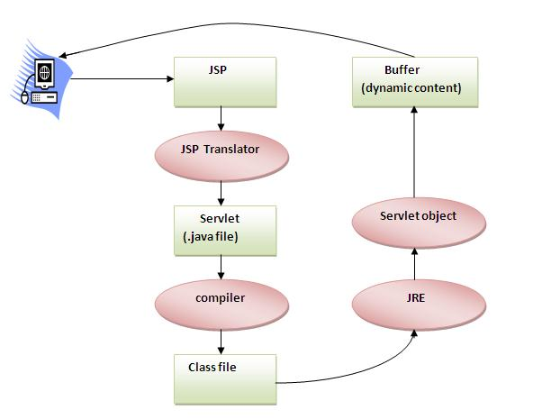

Slide 286
As depicted in the above diagram, JSP page is translated into servlet by the help of JSP translator.
The JSP translator is a part of webserver that is responsible to translate the JSP page into servlet.
After that Servlet page is compiled by the compiler and gets converted into the class file.
Moreover, all the processes that happens in servlet is performed on JSP later like initialization, committing response to the browser and destroy.

Slide 287
Creating a simple JSP Page
To create the first jsp page, write some html code as given below, and save it by .jsp extension. We have save this file as index.jsp. Put it in a folder and paste the folder in the web-apps directory in apache tomcat to run the jsp page.
index.jspLet's see the simple example of JSP, here we are using the scriptlet tag to put java code in the JSP page. We will learn scriptlet tag later.
<html>
<body>
<% out.print(2*5); %>
</body>
</html>
It will print 10 on the browser.

Slide 288
How to run a simple JSP Page ?
Follow the following steps to execute this JSP page:
Start the server
put the jsp file in a folder and deploy on the server
visit the browser by the url http://localhost:portno/contextRoot/jspfile e.g. http://localhost:8888/myapplication/index.jsp

Slide 289
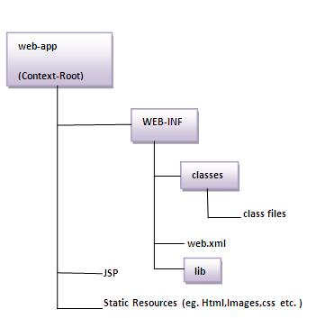
Directory structure of JSP
The directory structure of JSP page is same as servlet. We contains the jsp page outside the WEB-INF folder or in any directory.

Slide 290
The JSP API
The JSP API consists of two packages:
1.javax.servlet.jsp
2.javax.servlet.jsp.tagext
3.javax.servlet.jsp.el
javax.servlet.jsp package
The javax.servlet.jsp package has two interfaces and classes.
The two interfaces are as follows:
JspPage
HttpJspPage
The classes are as follows:
JspWriter
PageContext
JspFactory
JspEngineInfo
JspException
JspError
Exception classes:jsp,jsptag,skippage exception classes

Slide 291
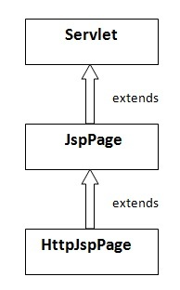
The JspPage interface
According to the JSP specification, all the generated servlet classes must implement the JspPage interface. It extends the Servlet interface. It provides two life cycle methods.

Slide 292
Methods of JspPage interface
public void jspInit(): It is invoked only once during the life cycle of the JSP when JSP page is requested firstly. It is used to perform initialization. It is same as the init() method of Servlet interface.
public void jspDestroy(): It is invoked only once during the life cycle of the JSP before the JSP page is destroyed. It can be used to perform some clean up operation.

Slide 293
The HttpJspPage interface
The HttpJspPage interface provides the one life cycle method of JSP. It extends the JspPage interface.
Method of HttpJspPage interface:
public void _jspService(): It is invoked each time when request for the JSP page comes to the container. It is used to process the request. The underscore _ signifies that you cannot override this method.

Slide 294
JSP Scriptlet tag (Scripting elements)
In JSP, java code can be written inside the jsp page using the scriptlet tag. Let's see what are the scripting elements first.
JSP Scripting elements
The scripting elements provides the ability to insert java code inside the jsp. There are three types of scripting elements:
scriptlet tag
expression tag
declaration tag

Slide 295
JSP scriptlet tag
A scriptlet tag is used to execute java source code in JSP. Syntax is as follows:
<% java source code %>
Example of JSP scriptlet tag
In this example, we are displaying a welcome message.
<html>
<body>
<% out.print("welcome to jsp"); %>
</body>
</html>

Slide 296
Example of JSP scriptlet tag that prints the user name
File: index.html
<html>
<body>
<form action="welcome.jsp">
<input type="text" name="uname">
<input type="submit" value="go"><br/>
</form>
</body>
</html>

Slide 297
File: welcome.jsp
<html>
<body>
<%
String name=request.getParameter("uname");
out.print("welcome "+name);
%>
</form>
</body>
</html>

Slide 298
JSP expression tag
The code placed within JSP expression tag is written to the output stream of the response. So you need not write out.print() to write data. It is mainly used to print the values of variable or method.
Syntax of JSP expression tag
<%= statement %>
Example of JSP expression tag
In this example of jsp expression tag, we are simply displaying a welcome message.
<html>
<body>
<%= "welcome to jsp" %>
</body>
</html>

Slide 299
Example of JSP expression tag that prints current time
To display the current time, we have used the getTime() method of Calendar class. The getTime() is an instance method of Calendar class, so we have called it after getting the instance of Calendar class by the getInstance() method.
index.jsp
<html>
<body>
Current Time: <%= java.util.Calendar.getInstance().getTime() %>
</body>
</html>

Slide 300
JSP Declaration Tag
The JSP declaration tag is used to declare fields and methods.
The code written inside the jsp declaration tag is placed outside the service() method of auto generated servlet.
So it doesn't get memory at each request.
Syntax of JSP declaration tag
The syntax of the declaration tag is as follows:
<%! field or method declaration %>

Slide 301
Difference between JSP Scriptlet tag and Declaration tag
Jsp Scriptlet Tag | Jsp Declaration Tag
The jsp scriptlet tag can only declare variables not methods. | The jsp declaration tag can declare variables as well as methods.
The declaration of scriptlet tag is placed inside the _jspService() method. | The declaration of jsp declaration tag is placed outside the _jspService() method.

Slide 302
Example of JSP declaration tag that declares field
In this example of JSP declaration tag, we are declaring the field and printing the value of the declared field using the jsp expression tag.
index.jsp
<html>
<body>
<%! int data=50; %>
<%= "Value of the variable is:"+data %>
</body>
</html>

Slide 304
Topics
JSP Fundamentals
JSP Scripting Elements
JSP Implicit Objects
JSP Directives
JSP Actions
JSP Example (Loan Calculator)
Servlets & JSPs together
Tag Libraries
Deploying and Running a JSP Application
Notes:
Prevention: locks at doors, window bars, walls round the property
Detection: stolen items are missing, burglar alarms, closed circuit TV
Reaction: call the police, replace stolen items, make an insurance claim …
Prevention: encrypt your orders, rely on the merchant to perform checks on the caller, don’t use the Internet (?) …
Detection: an unauthorized transaction appears on your credit card statement
Reaction: complain, ask for a new card number, etc.

Slide 305
Java Server Pages (JSP) Fundamentals
Java Server Pages are HTML pages embedded with snippets of Java code.
It is an inverse of a Java Servlet
Four different elements are used in constructing JSPs
Scripting Elements
Implicit Objects
Directives
Actions
Notes:
Prevention: locks at doors, window bars, walls round the property
Detection: stolen items are missing, burglar alarms, closed circuit TV
Reaction: call the police, replace stolen items, make an insurance claim …
Prevention: encrypt your orders, rely on the merchant to perform checks on the caller, don’t use the Internet (?) …
Detection: an unauthorized transaction appears on your credit card statement
Reaction: complain, ask for a new card number, etc.

Slide 306
Java Server Pages (JSP) Architecture
JSPs run in two phases
Translation Phase
Execution Phase
In translation phase JSP page is compiled into a servlet
called JSP Page Implementation class
In execution phase the compliled JSP is processed
Receive
Request
HTTP Server
JSP Container
Page Compiler Servlet
JSP Servlet
Current?
No
Parse JSP
Yes
JSP Servlet
Loaded?
Generate JSP
Servlet Source
Yes
No
Load Servlet
Compile JSP
Servlet
JSP Page Servlet
Generate
Response
Send
Response
Notes:
Prevention: locks at doors, window bars, walls round the property
Detection: stolen items are missing, burglar alarms, closed circuit TV
Reaction: call the police, replace stolen items, make an insurance claim …
Prevention: encrypt your orders, rely on the merchant to perform checks on the caller, don’t use the Internet (?) …
Detection: an unauthorized transaction appears on your credit card statement
Reaction: complain, ask for a new card number, etc.

Slide 307
Scripting Elements Types
There are three kinds of scripting elements
Declarations
Scriptlets
Expressions
Notes:
Prevention: locks at doors, window bars, walls round the property
Detection: stolen items are missing, burglar alarms, closed circuit TV
Reaction: call the police, replace stolen items, make an insurance claim …
Prevention: encrypt your orders, rely on the merchant to perform checks on the caller, don’t use the Internet (?) …
Detection: an unauthorized transaction appears on your credit card statement
Reaction: complain, ask for a new card number, etc.

Slide 308
Declarations Basics
Declarations are used to define methods & instance variables
Do not produce any output that is sent to client
Embedded in <%! and %> delimiters
Example:
<%!
Public void jspDestroy() {
System.out.println(“JSP Destroyed”);
}
Public void jspInit() {
System.out.println(“JSP Loaded”);
}
int myVar = 123;
%>
The functions and variables defined are available to the JSP Page as well as to the servlet in which it is compiled
Notes:
Prevention: locks at doors, window bars, walls round the property
Detection: stolen items are missing, burglar alarms, closed circuit TV
Reaction: call the police, replace stolen items, make an insurance claim …
Prevention: encrypt your orders, rely on the merchant to perform checks on the caller, don’t use the Internet (?) …
Detection: an unauthorized transaction appears on your credit card statement
Reaction: complain, ask for a new card number, etc.

Slide 309
Scriptlets Basics
Used to embed java code in JSP pages.
Contents of JSP go into _JSPpageservice() method
Code should comply with syntactical and semantic constuct of java
Embedded in <% and %> delimiters
Example:
<%
int x = 5;
int y = 7;
int z = x + y;
%>
Notes:
Prevention: locks at doors, window bars, walls round the property
Detection: stolen items are missing, burglar alarms, closed circuit TV
Reaction: call the police, replace stolen items, make an insurance claim …
Prevention: encrypt your orders, rely on the merchant to perform checks on the caller, don’t use the Internet (?) …
Detection: an unauthorized transaction appears on your credit card statement
Reaction: complain, ask for a new card number, etc.

Slide 310
Expressions Basics
Used to write dynamic content back to the browser.
If the output of expression is Java primitive the value is printed back to the browser
If the output is an object then the result of calling toString on the object is output to the browser
Embedded in <%= and %> delimiters
Example:
<%=“Fred”+ “ “ + “Flintstone %>
prints “Fred Flintstone” to the browser
<%=Math.sqrt(100)%>
prints 10 to the browser
Notes:
Prevention: locks at doors, window bars, walls round the property
Detection: stolen items are missing, burglar alarms, closed circuit TV
Reaction: call the police, replace stolen items, make an insurance claim …
Prevention: encrypt your orders, rely on the merchant to perform checks on the caller, don’t use the Internet (?) …
Detection: an unauthorized transaction appears on your credit card statement
Reaction: complain, ask for a new card number, etc.

Slide 311
Java Implicit Objects Scope
Implicit objects provide access to server side objects
e.g. request, response, session etc.
There are four scopes of the objects
Page: Objects can only be accessed in the page where they are referenced
Request: Objects can be accessed within all pages that serve the current request.
(Including the pages that are forwarded to and included in the original jsp page)
Session: Objects can be accessed within the JSP pages for which the objects are defined
Application: Objects can be accessed by all JSP pages in a given context
Notes:
Prevention: locks at doors, window bars, walls round the property
Detection: stolen items are missing, burglar alarms, closed circuit TV
Reaction: call the police, replace stolen items, make an insurance claim …
Prevention: encrypt your orders, rely on the merchant to perform checks on the caller, don’t use the Internet (?) …
Detection: an unauthorized transaction appears on your credit card statement
Reaction: complain, ask for a new card number, etc.

Slide 312
Java Implicit Objects List
request: Reference to the current request
response: Response to the request
session: session associated woth current request
application: Servlet context to which a page belongs
pageContext: Object to access request, response, session and application associated with a page
config: Servlet configuration for the page
out: Object that writes to the response output stream
page: instance of the page implementation class (this)
exception: Available with JSP pages which are error pages
Notes:
Prevention: locks at doors, window bars, walls round the property
Detection: stolen items are missing, burglar alarms, closed circuit TV
Reaction: call the police, replace stolen items, make an insurance claim …
Prevention: encrypt your orders, rely on the merchant to perform checks on the caller, don’t use the Internet (?) …
Detection: an unauthorized transaction appears on your credit card statement
Reaction: complain, ask for a new card number, etc.

Slide 313
Java Implicit Objects Example
<html>
<head>
<title>Implicit Objects</title>
</head>
<body style="font-family:verdana;font-size:10pt">
<p>
Using Request parameters...<br>
<b>Name:</b> <%= request.getParameter("name") %>
</p>
<p>
<% out.println("This is printed using the out implicit variable"); %>
</p>
<p>
Storing a string to the session...<br>
<% session.setAttribute("name", "Meeraj"); %>
Retrieving the string from session...<br>
<b>Name:</b> <%= session.getAttribute("name") %>
</p>
<p>
Storing a string to the application...<br>
<% application.setAttribute("name", "Meeraj"); %>
Retrieving the string from application...<br>
<b>Name:</b>
<%= application.getAttribute("name") %>
</p>
<p>
Storing a string to the page context...<br>
<% pageContext.setAttribute("name", "Meeraj"); %>
Retrieving the string from page context...</br>
<b>Name:</b>
<%= pageContext.getAttribute("name") %>
</p>
</body>
</html>
Notes:
Potential Damages:
1. Change orders placed by the client (Instead of 500 widgets he can make the order 50,000 widgets)
2. Change meeting venues to send people on wild goose chases

Slide 314
Example Implicit Objects Deploy & Run
Save file:
$TOMCAT_HOME/webapps/jsp/Implicit.jsp
Access file
http://localhost:8080/jsp/Implicit.jsp?name=Sanjay
Results of the execution
Using Request parameters... Name: sanjay
This is printed using the out implicit variable
Storing a string to the session... Retrieving the string from session... Name: Meeraj
Storing a string to the application... Retrieving the string from application... Name: Meeraj
Storing a string to the page context... Retrieving the string from page context... Name: Meeraj
Notes:
Potential Damages:
1. Change orders placed by the client (Instead of 500 widgets he can make the order 50,000 widgets)
2. Change meeting venues to send people on wild goose chases

Slide 315
Directives Basics & Types
Messages sent to the JSP container
Aids the container in page translation
Used for
Importing tag libraries
Import required classes
Set output buffering options
Include content from external files
The jsp specification defines three directives
Page: provder information about page, such as scripting language that is used, content type, or buffer size
Include – used to include the content of external files
Taglib – used to import custom actions defined in tag libraries
Notes:
Potential Damages:
1. Change orders placed by the client (Instead of 500 widgets he can make the order 50,000 widgets)
2. Change meeting venues to send people on wild goose chases

Slide 316
Page Directives Basics & Types
Page directive sets page properties used during translation
JSP Page can have any number of directives
Import directive can only occur once
Embedded in <%@ and %> delimiters
Different directives are
Language: (Default Java) Defines server side scripting language (e.g. java)
Extends: Declares the class which the servlet compiled from JSP needs to extend
Import: Declares the packages and classes that need to be imported for using in the java code (comma separated list)
Session: (Default true) Boolean which says if the session implicit variable is allowed or not
Buffer: defines buffer size of the jsp in kilobytes (if set to none no buffering is done)
Notes:
Potential Damages:
1. Change orders placed by the client (Instead of 500 widgets he can make the order 50,000 widgets)
2. Change meeting venues to send people on wild goose chases

Slide 317
Page Directives Types con’t.
Different directives are (cont’d.)
autoFlush:When true the buffer is flushed when max buffer size is reached (if set to false an exception is thrown when buffer exceeds the limit)
isThreadSafe: (default true) If false the compiled servlet implements SingleThreadModel interface
Info: String returned by the getServletInfo() of the compiled servlet
errorPage: Defines the relative URI of web resource to which the response should be forwarded in case of an exception
contentType: (Default text/html) Defines MIME type for the output response
isErrorPage: True for JSP pages that are defined as error pages
pageEncoding: Defines the character encoding for the jsp page
Notes:
Potential Damages:
1. Change orders placed by the client (Instead of 500 widgets he can make the order 50,000 widgets)
2. Change meeting venues to send people on wild goose chases

Slide 318
Page Directives Example
<%@
page language=“java”
buffer=“10kb”
autoflush=“true”
errorPage=“/error.jsp”
import=“java.util.*, javax.sql.RowSet”
%>
Notes:
Potential Damages:
1. Change orders placed by the client (Instead of 500 widgets he can make the order 50,000 widgets)
2. Change meeting venues to send people on wild goose chases

Slide 319
Include Directive Basics
Used to insert template text and JSP code during the translation phase.
The content of the included file specified by the directive is included in the including JSP page
Example
<%@ include file=“included.jsp” %>
Notes:
Potential Damages:
1. Change orders placed by the client (Instead of 500 widgets he can make the order 50,000 widgets)
2. Change meeting venues to send people on wild goose chases

Slide 320
JSP Actions Basics & Types
Processed during the request processing phase.
As opposed to JSP directives which are processed during translation
Standard actions should be supported by J2EE compliant web servers
Custom actions can be created using tag libraries
The different actions are
Include action
Forward action
Param action
useBean action
getProperty action
setProperty action
plugIn action
Notes:
Potential Damages:
1. Change orders placed by the client (Instead of 500 widgets he can make the order 50,000 widgets)
2. Change meeting venues to send people on wild goose chases

Slide 321
JSP Actions Include
Include action used for including resources in a JSP page
Include directive includes resources in a JSP page at translation time
Include action includes response of a resource into the response of the JSP page
Same as including resources using RequestDispatcher interface
Changes in the included resource reflected while accessing the page.
Normally used for including dynamic resources
Example
<jsp:include page=“inlcudedPage.jsp”>
Includes the the output of includedPage.jsp into the page where this is included.
Notes:
Potential Damages:
1. Change orders placed by the client (Instead of 500 widgets he can make the order 50,000 widgets)
2. Change meeting venues to send people on wild goose chases

Slide 322
JSP Actions Forward
Forwards the response to other web specification resources
Same as forwarding to resources using RequestDispatcher interface
Forwarded only when content is not committed to other web application resources
Otherwise an IllegalStateException is thrown
Can be avoided by setting a high buffer size for the forwarding jsp page
Example
<jsp:forward page=“Forwarded.html”>
Forwards the request to Forwarded.html
Notes:
Potential Damages:
1. Change orders placed by the client (Instead of 500 widgets he can make the order 50,000 widgets)
2. Change meeting venues to send people on wild goose chases

Slide 323
JSP Actions Param
Used in conjunction with Include & Forward actions to include additional request parameters to the included or forwarded resource
Example
<jsp:forward page=“Param2.jsp”>
<jsp:param name=“FirstName” value=“Sanjay”>
</jsp:forward>
This will result in the forwarded resource having an additional parameter FirstName with a value of Sanjay
Notes:
Potential Damages:
1. Change orders placed by the client (Instead of 500 widgets he can make the order 50,000 widgets)
2. Change meeting venues to send people on wild goose chases

Slide 324
JSP Actions useBean
Creates or finds a Java object with the defined scope.
Object is also available in the current JSP as a scripting variable
Syntax:
<jsp:useBean id=“name”
scope=“page | request | session | application”
class=“className” type=“typeName” |
bean=“beanName” type=“typeName” |
type=“typeName” />
At least one of the type and class attributes must be present
We can’t specify values for bith the class and bean name.
Example
<jsp:useBean id=“myName” scope=“request” class=“java.lang.String”>
<% firstName=“Sanjay”; %>
</jsp:useBean>
Notes:
Potential Damages:
1. Change orders placed by the client (Instead of 500 widgets he can make the order 50,000 widgets)
2. Change meeting venues to send people on wild goose chases

Slide 325
JSP Actions get/setProperty
getProperty is used in conjunction with useBean to get property values of the bean defined by the useBean action
Example (getProperty)
<jsp:getProperty name=“myBean” property=“firstName” />
Name corresponds to the id value in the useBean
Property refers to the name of the bean property
setProperty is used to set bean properties
Example (setProperty)
<jsp:setProperty name=“myBean” property=“firstName” value=“Sanjay”/>
Sets the name property of myBean to SanjayExample (setProperty)
<jsp:setProperty name=“myBean” property=“firstName” param=“fname”/>
Sets the name property of myBean to the request parameter fname
<jsp:setProperty name=“myBean” property=“*”>
Sets property to the corresponding value in request
Notes:
Potential Damages:
1. Change orders placed by the client (Instead of 500 widgets he can make the order 50,000 widgets)
2. Change meeting venues to send people on wild goose chases

Slide 326
JSP Actions plugIn
Enables the JSP container to render appropriate HTML (based on the browser type) to:
Initiate the download of the Java plugin
Execution of the specified applet or bean
plugIn standard action allows the applet to be embedded in a browser neutral fashion
Example
<jsp: plugin type=“applet” code=“MyApplet.class” codebase=“/”>
<jsp:params>
<jsp:param name=“myParam” value=“122”/>
</jsp:params>
<jsp:fallback><b>Unable to load applet</b></jsp:fallback>
</jsp:plugin>
Notes:
Potential Damages:
1. Change orders placed by the client (Instead of 500 widgets he can make the order 50,000 widgets)
2. Change meeting venues to send people on wild goose chases

Slide 327
Example Loan Calculator
Gets input to compute loan from user →
index.jsp
Header.jsp
Footer.jsp
Selects the right jsp for calculating loan →
controller.jsp
Computes loan based on simple interest
simple.jsp
Header.jsp
Footer.jsp
compound.jsp
Computes loan based on simple interest
error.jsp
Calculate loan
error.jsp
Calculate loan
Handles error if exception is thrown
Handles error if exception is thrown
Notes:
Potential Damages:
1. Change orders placed by the client (Instead of 500 widgets he can make the order 50,000 widgets)
2. Change meeting venues to send people on wild goose chases

Slide 328
Loan Calculator index.jsp
<html>
<head>
<title>Include</title>
</head>
<body style="font-family:verdana;font-size:10pt;">
<%@ include file="header.html" %>
<form action="controller.jsp">
<table border="0" style="font-family:verdana;font-size:10pt;">
<tr>
<td>Amount:</td>
<td><input type="text" name="amount" />
</tr>
<tr>
<td>Interest in %:</td>
<td><input type="text" name="interest"/></td>
</tr>
<tr>
<td>Compound:</td>
<td><input type="radio" name="type" value="C" checked/></td>
</tr>
<tr>
<td>Simple:</td>
<td><input type="radio" name="type" value="S" /></td>
</tr>
<tr>
<td>Period:</td>
<td><input type="text" name="period"/></td>
</tr>
</table>
<input type="submit" value="Calculate"/>
</form>
<jsp:include page="footer.jsp"/>
</body>
</html>
Notes:
Potential Damages:
1. Change orders placed by the client (Instead of 500 widgets he can make the order 50,000 widgets)
2. Change meeting venues to send people on wild goose chases

Slide 329
Loan Calculator Miscelaneous
controller.jsp
<%
String type = request.getParameter("type");
if(type.equals("S")) {
%>
<jsp:forward page="/simple.jsp"/>
<%
} else {
%>
<jsp:forward page="/compound.jsp"/>
<%
}
%>
error.jsp
<%@ page isErrorPage="true" %>
<html>
<head>
<title>Simple</title>
</head>
<body style="font-family:verdana;font-size:10pt;">
<%@ include file="header.html" %>
<p style="color=#FF0000"><b><%= exception.getMessage() %></b></p>
<jsp:include page="footer.jsp"/>
</body>
</html>
header.jsp
<h3>Loan Calculator</h3>
footer.jsp
<%= new java.util.Date() %>
Notes:
Potential Damages:
1. Change orders placed by the client (Instead of 500 widgets he can make the order 50,000 widgets)
2. Change meeting venues to send people on wild goose chases

Slide 330
Loan Calculator simple.jsp
<%@ page errorPage="error.jsp" %>
<%!
public double calculate(double amount, double interest, int period) {
if(amount <= 0) {
throw new IllegalArgumentException("Amount should be greater than 0: " + amount);
}
if(interest <= 0) {
throw new IllegalArgumentException("Interest should be greater than 0: " + interest);
}
if(period <= 0) {
throw new IllegalArgumentException("Period should be greater than 0: " + period);
}
return amount*(1 + period*interest/100);
}
%>
<html>
<head>
<title>Simple</title>
</head>
<body style="font-family:verdana;font-size:10pt;">
<%@ include file="header.html" %>
<%
double amount = Double.parseDouble(request.getParameter("amount"));
double interest = Double.parseDouble(request.getParameter("interest"));
int period = Integer.parseInt(request.getParameter("period"));
%>
<b>Pincipal using simple interest:</b>
<%= calculate(amount, interest, period) %>
<br/><br/>
<jsp:include page="footer.jsp"/>
</body>
</html>
Notes:
Potential Damages:
1. Change orders placed by the client (Instead of 500 widgets he can make the order 50,000 widgets)
2. Change meeting venues to send people on wild goose chases

Slide 331
Loan Calculator compound.jsp
<%@ page errorPage="error.jsp" %>
<%!
public double calculate(double amount, double interest, int period) {
if(amount <= 0) {
throw new IllegalArgumentException("Amount should be greater than 0: " + amount);
}
if(interest <= 0) {
throw new IllegalArgumentException("Interest should be greater than 0: " + interest);
}
if(period <= 0) {
throw new IllegalArgumentException("Period should be greater than 0: " + period);
}
return amount*Math.pow(1 + interest/100, period);
}
%>
<html>
<head>
<title>Compound</title>
</head>
<body style="font-family:verdana;font-size:10pt;">
<%@ include file="header.html" %>
<%
double amount = Double.parseDouble(request.getParameter("amount"));
double interest = Double.parseDouble(request.getParameter("interest"));
int period = Integer.parseInt(request.getParameter("period"));
%>
<b>Pincipal using compound interest:</b>
<%= calculate(amount, interest, period) %>
<br/><br/>
<jsp:include page="footer.jsp"/>
</body>
</html>
Notes:
Potential Damages:
1. Change orders placed by the client (Instead of 500 widgets he can make the order 50,000 widgets)
2. Change meeting venues to send people on wild goose chases

Slide 332
Example Inventory
Runs the SQL query for listing inventory
ListServlet
Takes the RowSet in the context and renders it
List.jsp
Renders form for new item
Runs SQL query to get a record from item
Deletes a record from the item table
EditServlet
New.html
DeleteServlet
Takes a RowSet and renders a form for editing
Edit.jsp
CreateServlet
Runs SQL query to update the data in the item table after editing
Runs SQL query to create new record
UpdateServlet
Notes:
Potential Damages:
1. Change orders placed by the client (Instead of 500 widgets he can make the order 50,000 widgets)
2. Change meeting venues to send people on wild goose chases

Slide 333
Inventory ListServlet
package edu.albany.mis.goel.servlets;
import javax.servlet.ServletException;
import javax.servlet.ServletConfig;
import javax.servlet.http.HttpServlet;
import javax.servlet.http.HttpServletRequest;
import javax.servlet.http.HttpServletResponse;
import javax.sql.DataSource;
import javax.sql.RowSet;
import sun.jdbc.rowset.CachedRowSet;
public class ListServlet extends HttpServlet {
public void init(ServletConfig config) throws ServletException {
super.init(config);
}
public void doPost(HttpServletRequest req, HttpServletResponse res)
throws ServletException {
doGet(req, res);
}
public void doGet(HttpServletRequest req, HttpServletResponse res)
throws ServletException {
try {
// Load the driver class
Class.forName("sun.jdbc.odbc.JdbcOdbcDriver");
// Define the data source for the driver
String sourceURL = "jdbc:odbc:inventoryDB";
RowSet rs = new CachedRowSet();
rs.setUrl(sourceURL);
rs.setCommand("select * from item");
rs.execute();
req.setAttribute("rs", rs);
getServletContext().getRequestDispatcher("/List.jsp").
forward(req, res);
} catch(Exception ex) {
throw new ServletException(ex);
}
}
}
Notes:
Potential Damages:
1. Change orders placed by the client (Instead of 500 widgets he can make the order 50,000 widgets)
2. Change meeting venues to send people on wild goose chases

Slide 334
Inventory EditServlet
package edu.albany.mis.goel.servlets;
import javax.servlet.ServletException;
import javax.servlet.ServletConfig;
import javax.servlet.http.HttpServlet;
import javax.servlet.http.HttpServletRequest;
import javax.servlet.http.HttpServletResponse;
import java.sql.DriverManager;
import javax.sql.DataSource;
import javax.sql.RowSet;
import sun.jdbc.rowset.CachedRowSet;
public class EditServlet extends HttpServlet {
public void init(ServletConfig config) throws ServletException {
super.init(config);
}
public void doPost(HttpServletRequest req, HttpServletResponse res)
throws ServletException {
doGet(req, res);
}
public void doGet(HttpServletRequest req, HttpServletResponse res)
throws ServletException {
try {
// Load the driver class
Class.forName("sun.jdbc.odbc.JdbcOdbcDriver");
// Define the data source for the driver
String sourceURL = "jdbc:odbc:inventoryDB";
RowSet rs = new CachedRowSet();
rs.setUrl(sourceURL);
rs.setCommand("select * from item where id = ?");
rs.setInt(1, Integer.parseInt(req.getParameter("id")));
rs.execute();
req.setAttribute("rs", rs);
getServletContext().getRequestDispatcher("/Edit.jsp").forward(req, res);
} catch(Exception ex) {
throw new ServletException(ex);
}
}
}
Notes:
Potential Damages:
1. Change orders placed by the client (Instead of 500 widgets he can make the order 50,000 widgets)
2. Change meeting venues to send people on wild goose chases

Slide 335
Inventory UpdateServlet
package edu.albany.mis.goel.servlets;
import javax.servlet.ServletException;
import javax.servlet.ServletConfig;
import javax.servlet.http.HttpServlet;
import javax.servlet.http.HttpServletRequest;
import javax.servlet.http.HttpServletResponse;
import javax.sql.DataSource;
import javax.naming.InitialContext;
import java.sql.DriverManager;
import java.sql.Connection;
import java.sql.PreparedStatement;
import java.sql.ResultSet;
public class UpdateServlet extends HttpServlet {
public void init(ServletConfig config) throws ServletException {
super.init(config);
}
public void doPost(HttpServletRequest req, HttpServletResponse res)
throws ServletException {
doGet(req, res);
}
public void doGet(HttpServletRequest req, HttpServletResponse res)
throws ServletException {
Connection con = null;
try {
// Load the driver class
Class.forName("sun.jdbc.odbc.JdbcOdbcDriver");
// Define the data source for the driver
String sourceURL = "jdbc:odbc:inventoryDB";
// Create a connection through the DriverManager class
con = DriverManager.getConnection(sourceURL);
System.out.println("Connected Connection");
PreparedStatement stmt= con.prepareStatement
("update item " + "set name = ?, " + "description = ?, " + "price = ?, "
+ "stock = ? " + "where id = ?");
stmt.setString(1, req.getParameter("name"));
stmt.setString(2, req.getParameter("description"));
stmt.setDouble(3, Double.parseDouble(req.getParameter("price")));
stmt.setInt(4, Integer.parseInt(req.getParameter("stock")));
stmt.setInt(5, Integer.parseInt(req.getParameter("id")));
stmt.executeUpdate();
stmt.close();
getServletContext().getRequestDispatcher("/List").
forward(req, res);
} catch(Exception ex) {
throw new ServletException(ex);
} finally {
try {
if(con != null) {
con.close();
}
} catch(Exception ex) {
throw new ServletException(ex);
}
}
}
}
Notes:
Potential Damages:
1. Change orders placed by the client (Instead of 500 widgets he can make the order 50,000 widgets)
2. Change meeting venues to send people on wild goose chases

Slide 336
Inventory DeleteServlet
package edu.albany.mis.goel.servlets;
import javax.servlet.ServletException;
import javax.servlet.ServletConfig;
import javax.servlet.http.HttpServlet;
import javax.servlet.http.HttpServletRequest;
import javax.servlet.http.HttpServletResponse;
import javax.sql.DataSource;
import javax.naming.InitialContext;
import java.sql.Connection;
import java.sql.DriverManager;
import java.sql.PreparedStatement;
import java.sql.ResultSet;
public class DeleteServlet extends HttpServlet {
public void init(ServletConfig config) throws ServletException {
super.init(config);
}
public void doPost(HttpServletRequest req, HttpServletResponse res)
throws ServletException {
doGet(req, res);
}
public void doGet(HttpServletRequest req, HttpServletResponse res)
throws ServletException {
Connection con = null;
try {
// Load the driver class
Class.forName("sun.jdbc.odbc.JdbcOdbcDriver");
// Define the data source for the driver
String sourceURL = "jdbc:odbc:inventoryDB";
// Create a connection through the DriverManager class
con = DriverManager.getConnection(sourceURL);
System.out.println("Connected Connection");
// Create Statement
PreparedStatement stmt =
con.prepareStatement("delete from item where id = ?");
stmt.setInt(1, Integer.parseInt(req.getParameter("id")));
stmt.executeUpdate();
stmt.close();
getServletContext().getRequestDispatcher("/List").
forward(req, res);
} catch(Exception ex) {
throw new ServletException(ex);
} finally {
try {
if(con != null) con.close();
} catch(Exception ex) {
throw new ServletException(ex);
}
}
}
}
Notes:
Potential Damages:
1. Change orders placed by the client (Instead of 500 widgets he can make the order 50,000 widgets)
2. Change meeting venues to send people on wild goose chases

Slide 337
Inventory CreateServlet
package edu.albany.mis.goel.servlets;
import javax.servlet.ServletException;
import javax.servlet.ServletConfig;
import javax.servlet.http.HttpServlet;
import javax.servlet.http.HttpServletRequest;
import javax.servlet.http.HttpServletResponse;
import javax.sql.DataSource;
import javax.naming.InitialContext;
import java.sql.DriverManager;
import java.sql.Connection;
import java.sql.PreparedStatement;
import java.sql.ResultSet;
public class CreateServlet extends HttpServlet {
public void init(ServletConfig config) throws ServletException {
super.init(config);
}
public void doPost(HttpServletRequest req, HttpServletResponse res)
throws ServletException {
doGet(req, res);
}
public void doGet(HttpServletRequest req, HttpServletResponse res)
throws ServletException {
Connection con = null;
try { // Load the driver class
Class.forName("sun.jdbc.odbc.JdbcOdbcDriver");
// Define the data source for the driver
String sourceURL = "jdbc:odbc:inventoryDB";
// Create a connection through the DriverManager class
con = DriverManager.getConnection(sourceURL);
System.out.println("Connected Connection");
PreparedStatement stmt = con.prepareStatement
("insert into item " + "(name,description,price,stock) " +
"values (?, ?, ?, ?)");
stmt.setString(1, req.getParameter("name"));
stmt.setString(2, req.getParameter("description"));
stmt.setDouble(3, Double.parseDouble(req.getParameter("price")));
stmt.setInt(4, Integer.parseInt(req.getParameter("stock")));
stmt.executeUpdate();
stmt.close();
getServletContext().getRequestDispatcher("/List").forward(req, res);
} catch(Exception ex) {
throw new ServletException(ex);
} finally {
try {
if(con != null) con.close();
} catch(Exception ex) {
throw new ServletException(ex);
}
}
}
}
Notes:
Potential Damages:
1. Change orders placed by the client (Instead of 500 widgets he can make the order 50,000 widgets)
2. Change meeting venues to send people on wild goose chases

Slide 338
Inventory Edit.jsp
<%@page contentType="text/html"%>
<jsp:useBean id="rs" scope="request" type="javax.sql.RowSet" />
<html>
<head>
<title>Inventory - Edit</title>
</head>
<body style="font-family:verdana;font-size:10pt;">
<%
if(rs.next()) {
%>
<form action="Update">
<input name="id" type="hidden" value="<%= rs.getString(1) %>"/>
<table cellpadding="5" style="font-family:verdana;font-size:10pt;">
<tr>
<td><b>Name:</b></td>
<td>
<input name="name" type="text" value="<%= rs.getString(2) %>"/>
</td>
</tr>
<tr>
<td><b>Description:</b></td>
<td>
<input name="description" type="text" value="<%= rs.getString(3) %>"/>
</td>
</tr>
<tr>
<td><b>Price:</b></td>
<td>
<input name="price" type="text" value="<%= rs.getString(4) %>"/>
</td>
</tr>
<tr>
<td><b>Stock:</b></td>
<td>
<input name="stock" type="text" value="<%= rs.getString(5) %>"/>
</td>
</tr>
<tr>
<td></td>
<td>
<input type="submit" value="Update"/>
</td>
</tr>
</table>
<%
}
%>
</body>
</html>
Notes:
Potential Damages:
1. Change orders placed by the client (Instead of 500 widgets he can make the order 50,000 widgets)
2. Change meeting venues to send people on wild goose chases

Slide 339
Inventory Edit.jsp
<%@page contentType="text/html"%>
<jsp:useBean id="rs" scope="request" type="javax.sql.RowSet" />
<html>
<head>
<title>Inventory - List</title>
</head>
<body style="font-family:verdana;font-size:10pt;">
<table cellpadding="5" style="font-family:verdana;font-size:10pt;">
<tr>
<th>Name</th>
<th>Description</th>
<th>Price</th>
<th>Stock</th>
<th></th>
<th></th>
</tr>
<%
while(rs.next()) {
%>
<tr>
<td><%= rs.getString(2) %></td>
<td><%= rs.getString(3) %></td>
<td><%= rs.getString(4) %></td>
<td><%= rs.getString(5) %></td>
<td>
<a href="Delete?id=<%= rs.getString(1) %>">
Delete
</a>
</td>
<td>
<a href="Edit?id=<%= rs.getString(1) %>">
Edit
</a>
</td>
</tr>
<%
}
%>
</table>
<a href="New.html">New Item</a>
</body>
</html>
Notes:
Potential Damages:
1. Change orders placed by the client (Instead of 500 widgets he can make the order 50,000 widgets)
2. Change meeting venues to send people on wild goose chases

Slide 340
Inventory New.html
<html>
<head>
<title>Inventory - Add New Item</title>
</head>
<body style="font-family:verdana;font-size:10pt;">
<form action="Create">
<table cellpadding="5" style="font-family:verdana;font-size:10pt;">
<tr>
<td><b>Name:</b></td>
<td><input name="name" type="text"/></td>
</tr>
<tr>
<td><b>Description:</b></td>
<td><input name="description" type="text"/></td>
</tr>
<tr>
<td><b>Price:</b></td>
<td><input name="price" type="text"/></td>
</tr>
<tr>
<td><b>Stock:</b></td>
<td><input name="stock" type="text"/></td>
</tr>
<tr>
<td></td>
<td><input type="submit" value="Create"/></td>
</tr>
</table>
</body>
</html>
Notes:
Potential Damages:
1. Change orders placed by the client (Instead of 500 widgets he can make the order 50,000 widgets)
2. Change meeting venues to send people on wild goose chases

